Slide 1

SAL INSTITUTE OF TECHNOLOGY AND ENGINEERING RESEARCH

Slide 2
BRANCH: COMPUTER ENGINEERING
SUBJECT : SUMMER INTERNSHIP(3170001)
COLLEGE: SAL INSTITUTE OF TECHNOLOGY AND ENGINEERING RESEARCH
PROJECT DEFINITION: RECOMMENDER SYSTEM WITH SENTIMENT ANALYSIS
PREPARED BY : YUKTA GURNANI (190670107026)
GUIDED BY : PROF. MIKI PATEL

Slide 3
CONTENTS
1. | INTERNSHIP CERTIFICATES
2. | ACKNOWLEDGEMENT
3. | ABSTRACT
4. | DAY – WISE TASKS
5. | PROJECT
6. | CONCLUSION

Slide 4
CHAPTER:1 INTERNSHIP CERTIFICATES
1.

Slide 5

Joining Certificate :

Slide 6

Completion Certificate :

Slide 7
CHAPTER:2 ACKNOWLEDGEMENT
2.

Slide 8
I would like to express my deepest gratitude to all those who provided me the support towards the completion of the internship. I would like to give a special gratitude of thanks to our internal guide, Miki Patel Mam whose contribution in stimulating suggestions and encouragement, helped me to complete the internship especially in drafting this report.
Furthermore, I would also like to acknowledge with much appreciation the crucial role of the Head of Department, Sudha Patel Mam, who gave the permission to use all required equipment and the necessary material to fulfil the task. Last but not the least, many thanks go to the teachers and my friends and families who have invested their full effort in guiding us in achieving the goal.
Also I appreciate the guidance given by the developer at BrainyBeam, Mr. Raj Makhijani Sir as well as the panels especially for the internship that has advised me and gave guidance at every moment of the internship.

Slide 9
CHAPTER:3 ABSTRACT
3.

Slide 10
Data Science and analysis is playing the most significant role today covering every industry in the market. For e.g., finance, e-commerce, business, education, government.
Now organizations play a 360-degree role to analyze the behavior and interest of their customers to take decisions in favor of them. Data is analyzed through programming language such as python which is one of the most versatile language and helps in doing a lot of things through it.
Netflix is a pure data science project that reached at the top through analyzing every single interest of their customers. Key terminology that are used in Data Science are: Data Visualization, Anaconda Jupyter Notebook, Exploratory Data Analysis, Machine Learning, Data wrangling, and Evaluation using scikit library’s surprise module.

Slide 11
CHAPTER:4 DAY – WISE TASKS
4.

Slide 12
INDEX
Sr. No. | Description
1 | Basic introduction and domain knowledge
2 | Datatypes in Python
3 | Implementing functions in python and using metacharacters for validation programs
4 | Implementing external and internal libraries and learning applications of pandas
5 | Learning to convert multiple Series to Dataframe
6 | Studying and implementing functions of numpy and matplotlib
7 | Using nltk packages and tokenizing, stemming, lemmatizing and distributing frequency of corpus data
8 | Understanding TF IDf Vectorization and loading a json file to find total words and sentences from that
9 | Implementing label encoding and cleaning the text using stopwords and re
10 | Learning to find cosine similarity
11 | Visualizing data
12 | Finding nearest neighbours and their distance values with their indices
13 | Building a recommendation engine using KNN
14 | Understanding radius and n_neighbours parameter of KNN
15 | Converting Recommendations into Dataframe
16 | Project- Book Recommendation System

Slide 13
DAY - 1
BASIC INTRODUCTION AND DOMAIN KNOWLEDGE
Introduction about Field
Discuss some basic point about python, working of python, advantages of python for working in data science.
Also explained how to install and run python and jupyter notebook and other useful tools?
Difference between Data Science, Data Analysis & Machine Learning
Data Science: Use mathematical skills for get desire outcome from data.
Data Analysis: Analyzing data with different charts and tables.
Machine Learning: Totally based on mathematics used for prediction, for building models etc.
Basic Linux Commands
cd – Use the cd command to change the directory
mkdir – use the mkdir command to create a folder or directory
touch – Create new file
rmdir- Deletes a directory
ls - Lists all the files and directories in the present working directory.
Pwd - Displays the path of the present working directory.
rm – use the rm command to delete files and directories.

Slide 14
TASK-1
Keywords In Python
There are 35 keywords in python which are as follows –
false, await, else, import, pass, none, break, except, in, raise, true, class, finally, is, return, and,
continue, for, lambda, try, as, def, from, nonlocal, while, assert, del, global, not, with, async, elif,
if, or, yield.
Operators In Python
Python divides the operators in the following groups:
Arithmetic operators => +, -, *, /, %, **, //
Assignment operators=> =, +=, -=, *=, /=, %=, //=, **=, &=, |=, ^=, >>=, <<=
Comparison operators=> ==, !=, >, <, >=, <=
Logical operators=> and, or, not,
Identity operators=> is, is not
Membership operators=> in, not in
Bitwise operators=> &, |, ^, ~, <<, >>

Slide 15
Various Sorting Algorithms And There Use In Real Life
Bubble sort is used in programming TV to sort channels based on audience viewing time!
Databases use external merge sort to sort sets of data that are too large to be loaded entirely into the memory.
Sports scores are quickly organized by quick sort in real-time.
Interpreter V/S Compiler
Interpreter – Interpreter interprets the source code line-by-line.
Example of interpreted languages- PHP, ruby, python, javascript.
Compiler- Compiler compiles whole file and shows error and then runs the file.
Example of compiled languages- C, C++, Go.

Slide 16
Why Python For Data Science
Features of python-
Fast
Interpreted language
Supports all libraries required for performing data science operations.
Python has 69 inbuilt modules
Modes in python-
Script / Normal mode – In mode, the code is scripted first and then the file is saved by .py extension and then executed.
Interactive- In this mode, command line shell gives immediate feedback.
Basic Terminologies
IDE, JSON, API

Slide 17
TASK-2
Types Of Data
These are 3 types: Structured data, Semi-structured data, and Unstructured data.
Structured data –
Structured data is data whose elements are addressable for effective analysis. It has been organized into a formatted repository that is typically a database. It concerns all data which can be stored in database SQL in a table with rows and columns. They have relational keys and can easily be mapped into pre-designed fields. Today, those data are most processed in the development and simplest way to manage information. Example: Relational data.
Semi-Structured data –
Semi-structured data is information that does not reside in a relational database but that has some organizational properties that make it easier to analyze. With some processes, you can store them in the relation database (it could be very hard for some kind of semi-structured data), but Semi-structured exist to ease space. Example: XML data.
Unstructured data –
Unstructured data is a data which is not organized in a predefined manner or does not have a predefined data model, thus it is not a good fit for a mainstream relational database. So for Unstructured data, there are alternative platforms for storing and managing, it is increasingly prevalent in IT systems and is used by organizations in a variety of business intelligence and analytics applications. Example: Word, PDF, Text, Media logs.

Slide 18
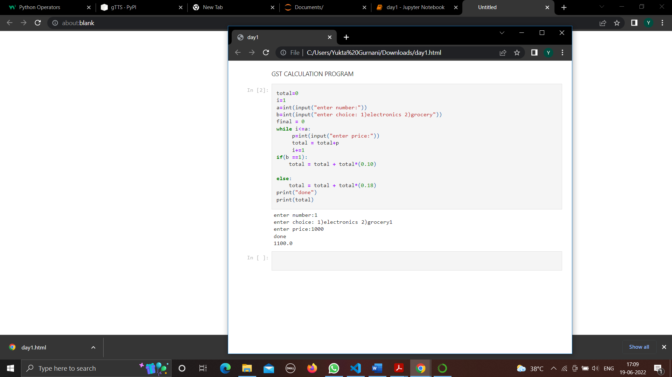
TASK-3
Build a Gst calculation program with multiple categories having different percentages.

Slide 19
DAY - 2
TASK-4
List out the methods used commonly in list, set, tuple, dictionary with their rules
Data Types in Python
str: A string data type is traditionally a sequence of characters, either as a literal constant or as some kind of variable. The latter may allow its elements to be mutated and the length changed, or it may be fixed (after creation).
Numbers: Int, float, complex and long integers are numeric data types. We can store real number values in int, floating point values in float and complex numbers in complex data types and long for integers of unlimited size.
Lists are the build-in data-types in python that are used to store multiple items in a single variables. The data is stored in [ ].
Sets are also used to store multiple items in a single variables. In set there is no order and no index. Data stored between { }.
Tuples: Similar to list the tuples are ordered and similar to set the tuples are immutable. Stored in ( ).
Dictionary: Storing of values ,Ordered , changeable(mutable) , doesn’t allow change of values.

Slide 20
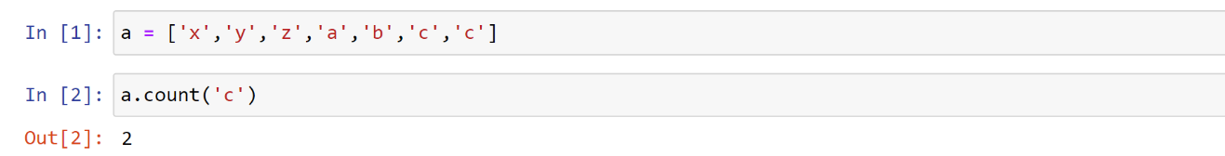
LIST:
Example: a= [‘Y’,’U’,’K’,’T’,’A’]
Lists are the build-in data-types in python that are used to store multiple items in a single variables. The plus point of list is that the order of list does not change, and the items in the list are changeable (mutable) and the last point as the list allows duplicate values too.
List rules-
1) Repeated values allowed
2) Ordered
3) Mutable
List Methods-
1) count(): Number of elements with the specified value

Slide 21
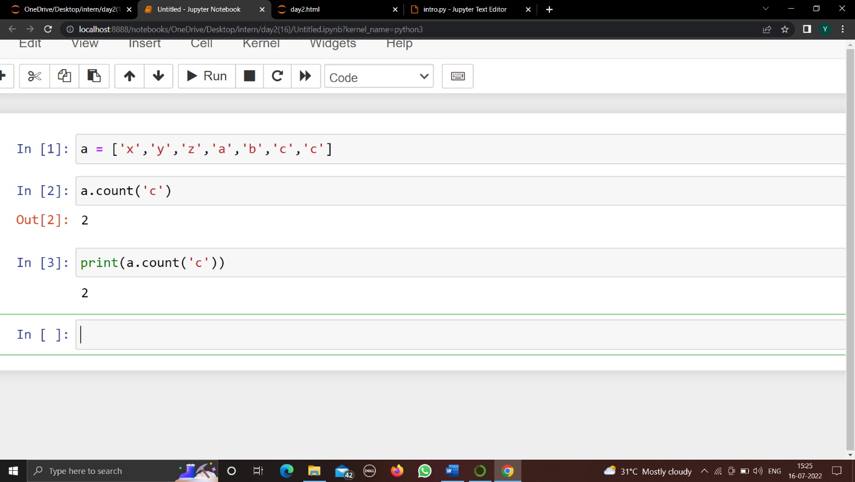
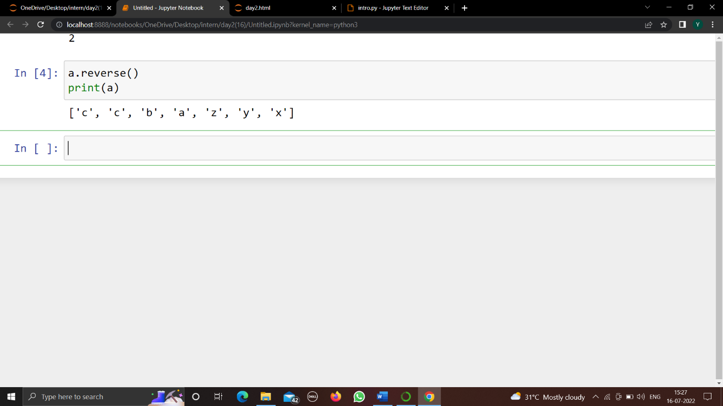
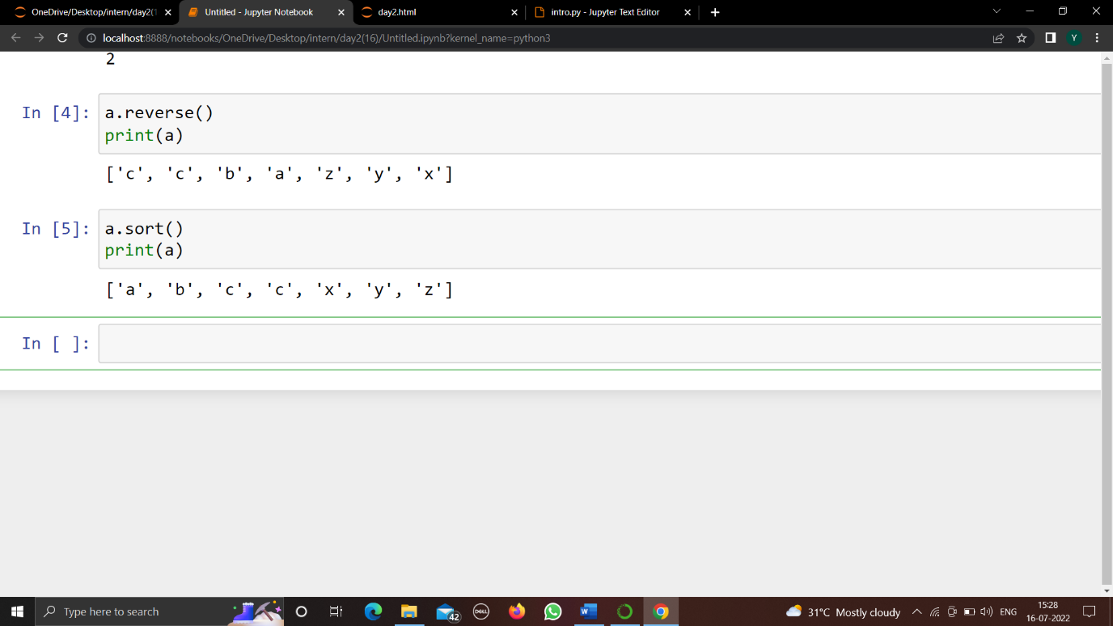
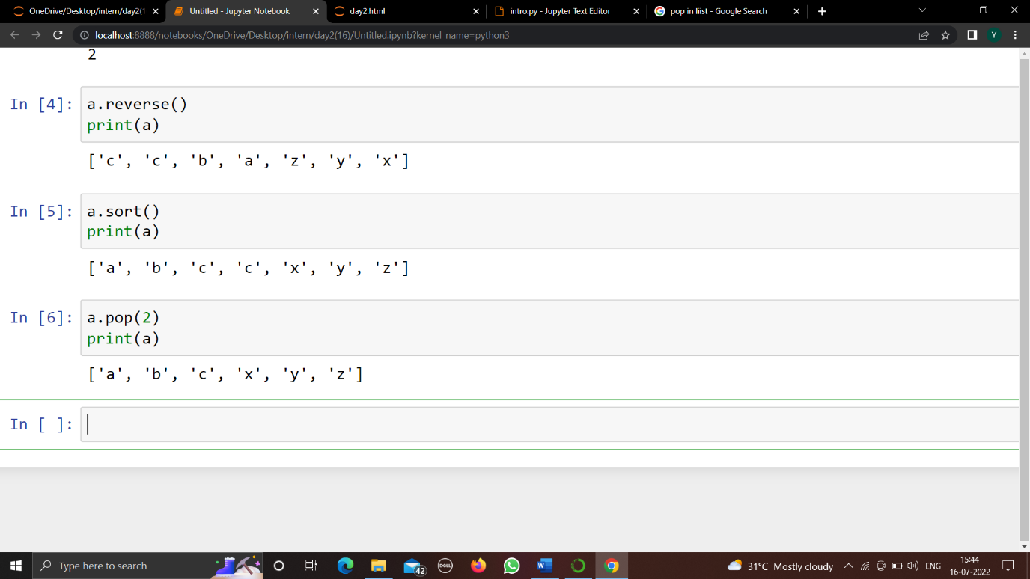
2) index(): The index() method returns the position at the first occurrence of the specified value.
3) reverse(): reverse the list
4) sort(): The sort() method sorts the list ascending by default.
5) pop(): The pop() method removes the item at the given index from the list and returns the removed item.

Slide 22
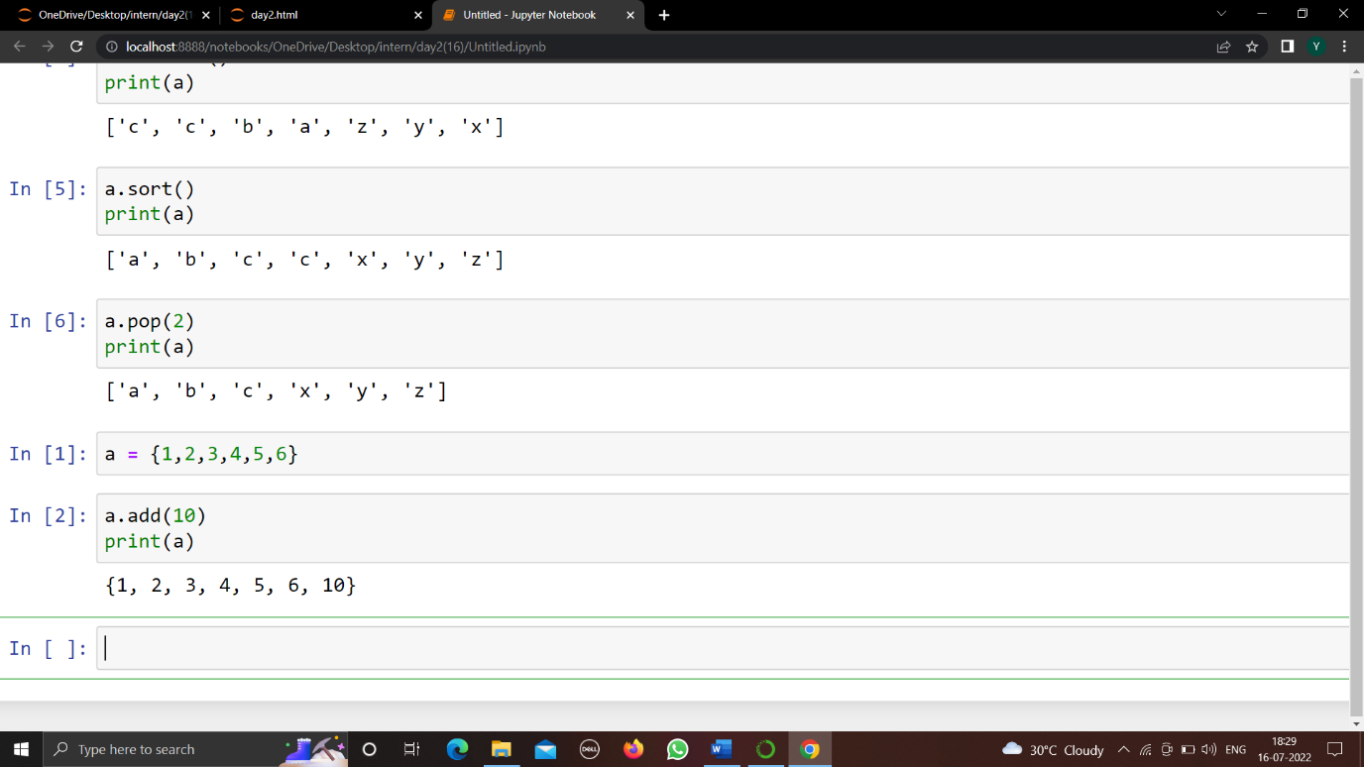
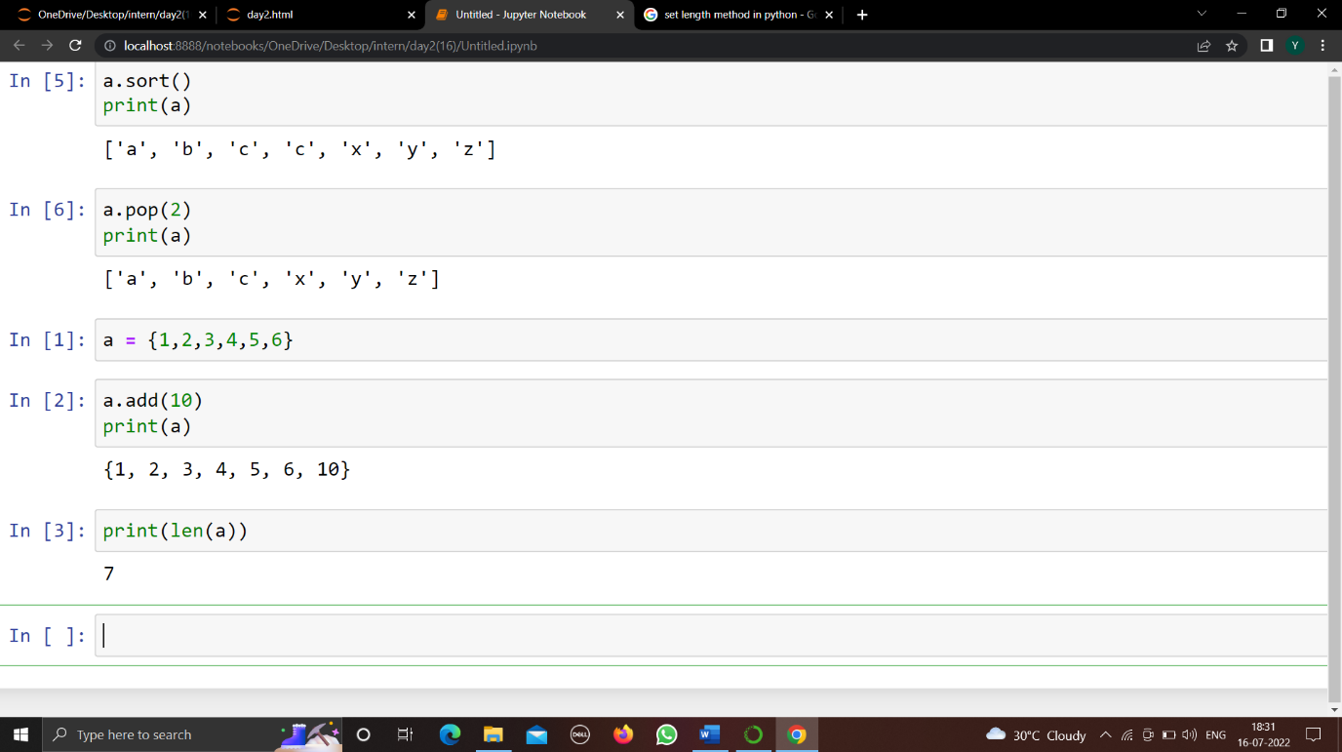
SET
Sets are also used to store multiple items in a single variables.
In set there is no order and no index.
The down point of set data type is the value cannot be changed once the set is created immutable
Repetition of values are not allowed in set.
Set Rules-
1)Duplicates not allowed
2)Unordered
Sets Methods-
1)add(): adds element to a set
2)len(): len() function returns the number of items in the set.

Slide 23
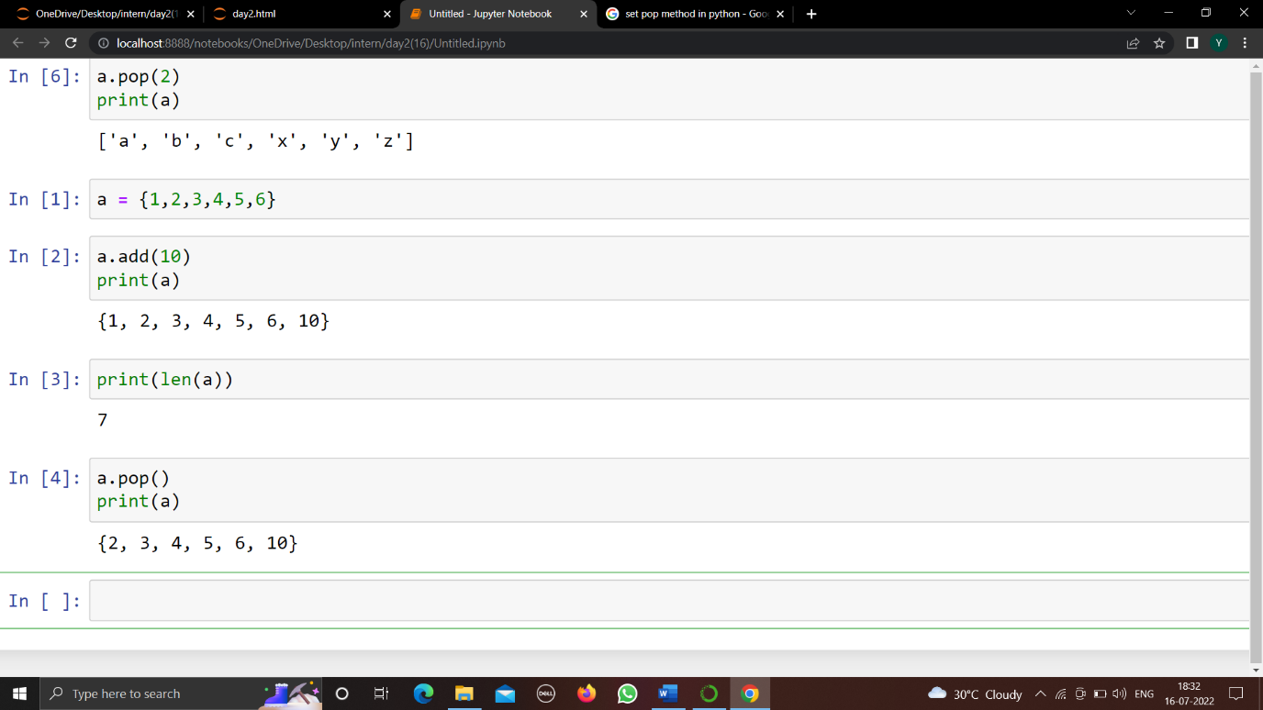
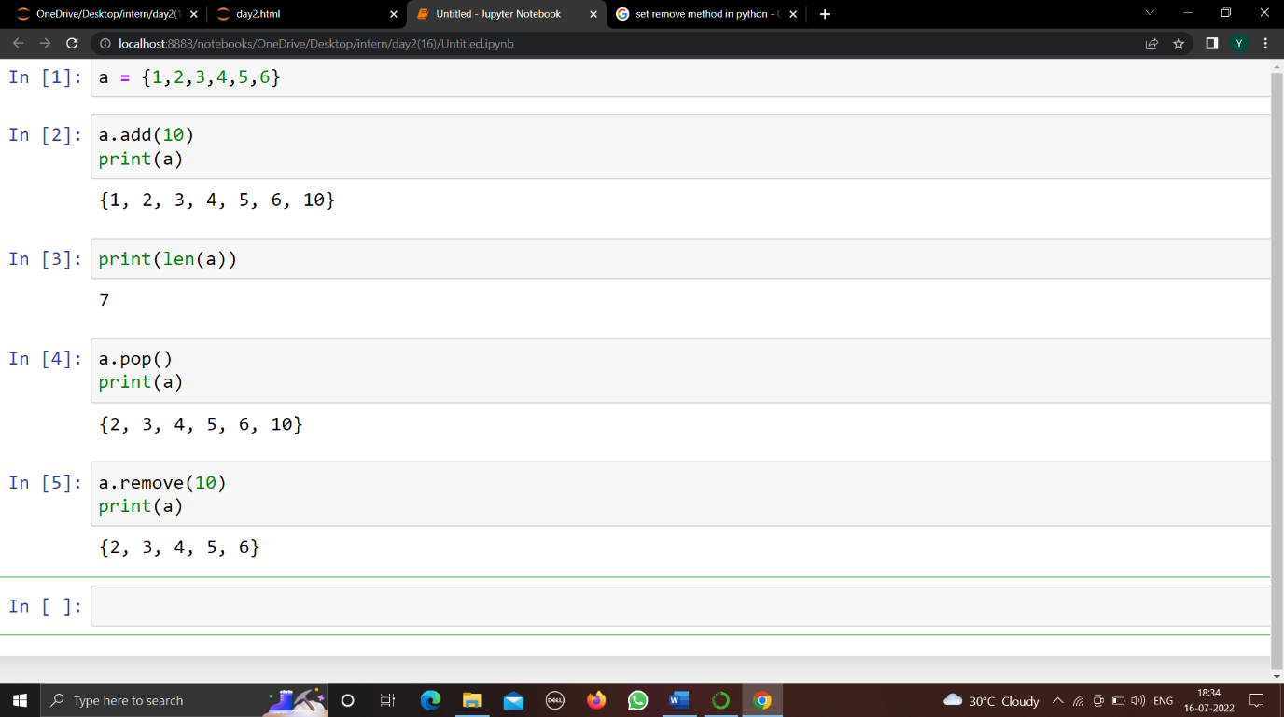

3)pop(): This method removes a top element from the set but not the random element and returns the removed element.
4)remove(): The remove() method removes the specified element from the set.
5)subset(): The issubset() method returns True if set A is the subset of B , i.e. if all the elements of set A are present in set B . Else, it returns false .

Slide 24
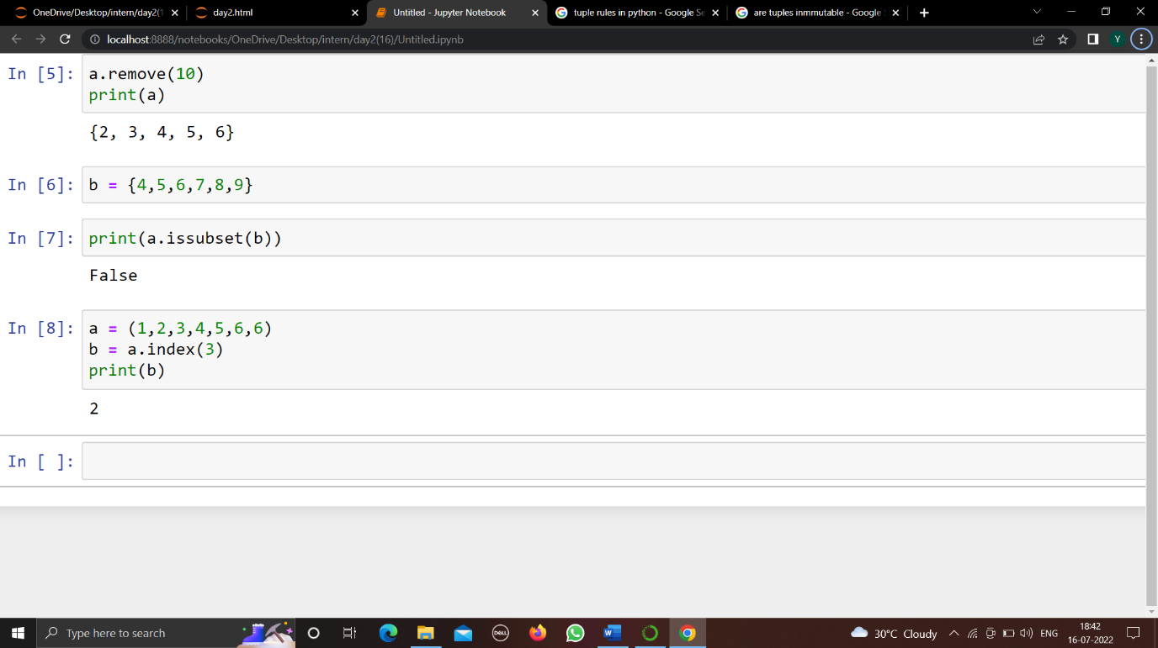

TUPLE
Storing of multiple items in one variable
Similar to list the tuples are ordered and similar to set the tuples are immutable.
Tuple Rules-
1) Immutable
2) Uses parentheses
Tuple Methods-
index( ): Searches the tuple for a specified value and returns the position of where it was found.
count( ): Returns the number of times a specified value occurs in a tuple.

Slide 25
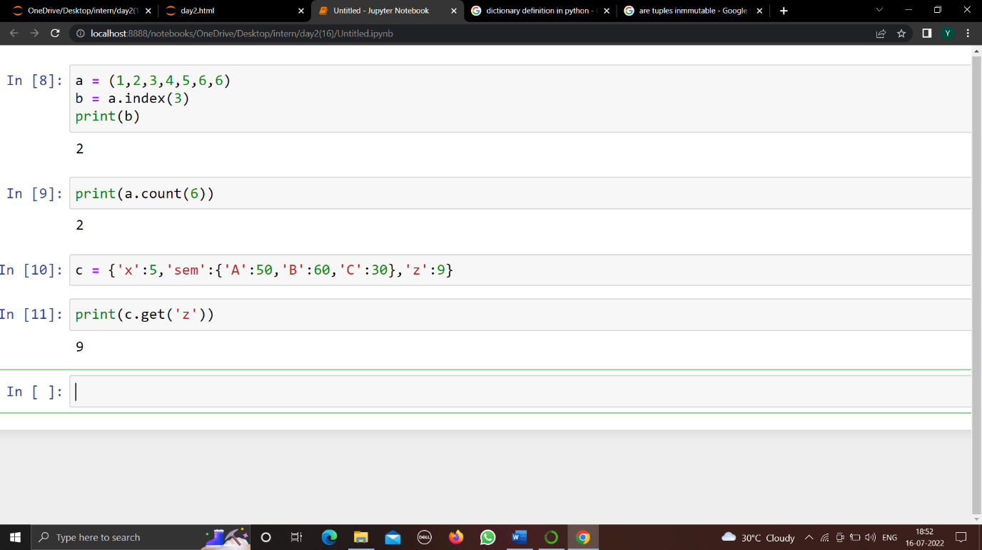
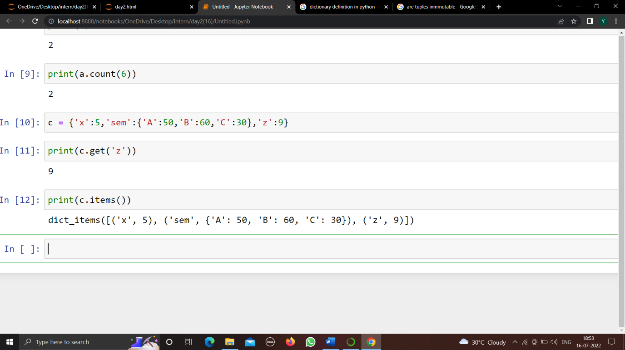
Dictionaries
Dictionary Rules-
1) Stores data values in key:value pairs.
2) Collection is ordered
3) Mutable
4) Does not allow duplicates
Dictionary Methods-
1)get(): Returns the value of the specified key
2) items(): Returns a list containing a tuple for each key value pair

Slide 26
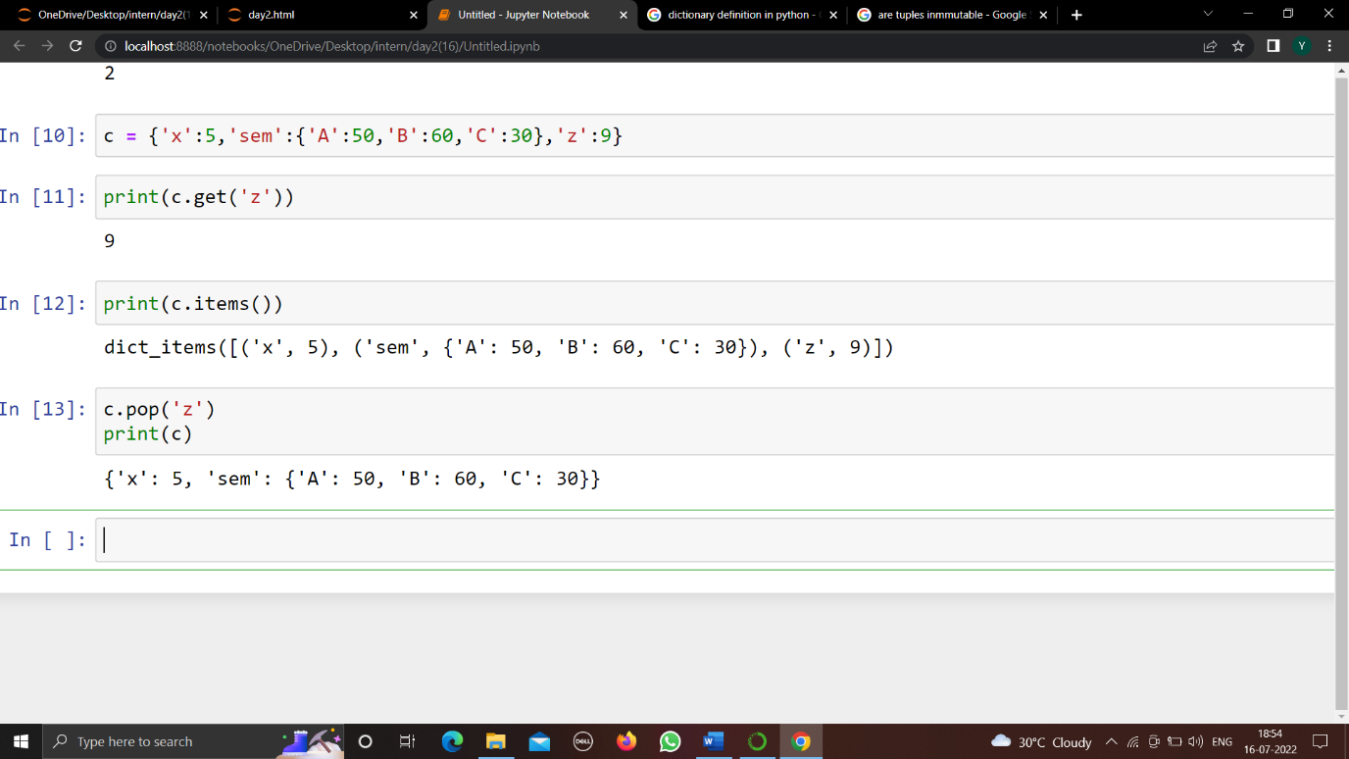
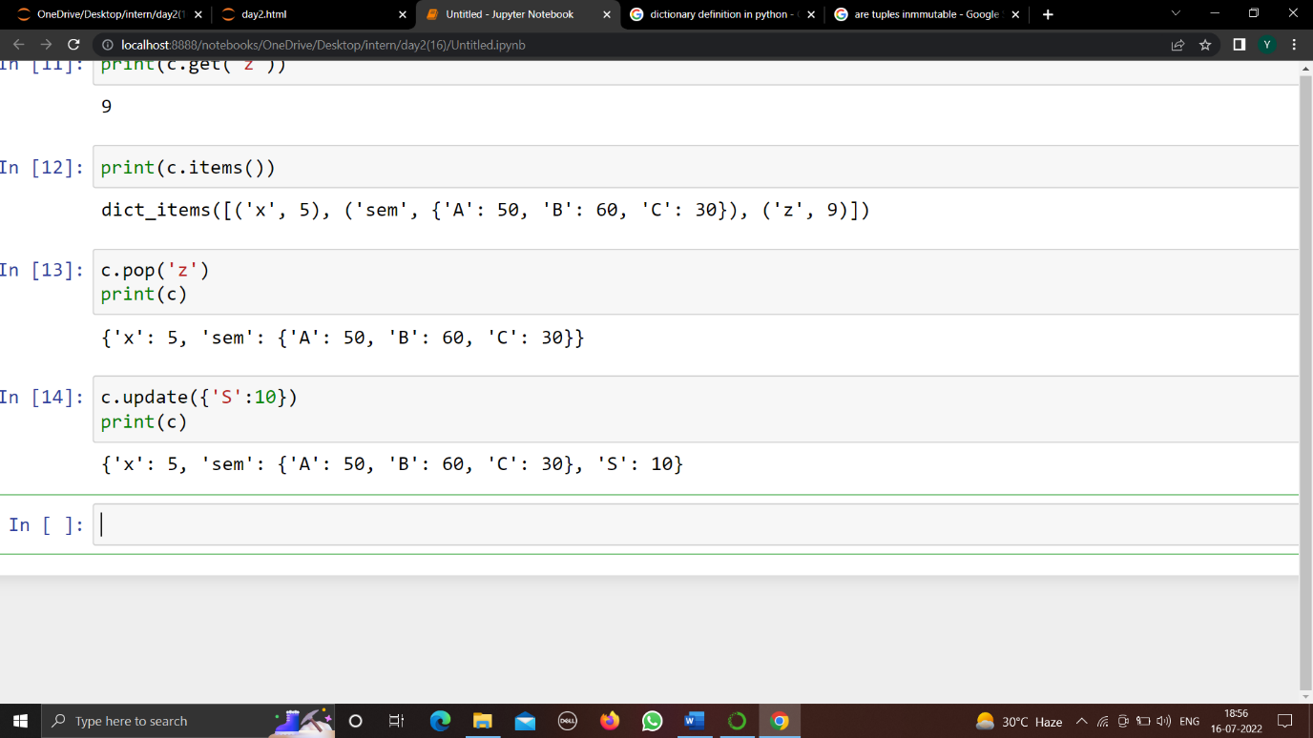
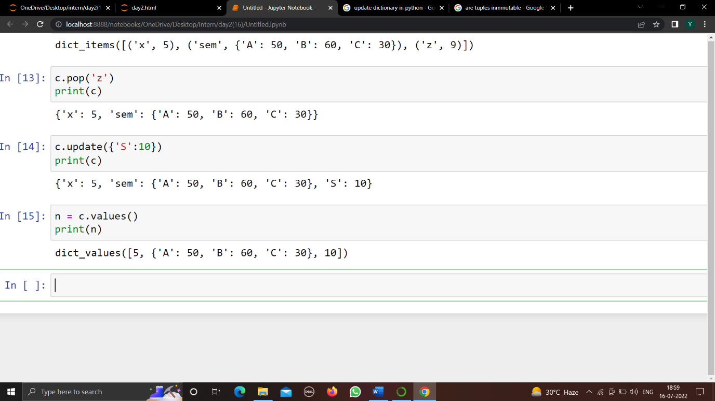
3) pop(): Removes the element with the specified key
4) update(): The update() method inserts the specified items to the dictionary. The specified items can be a dictionary, or an iterable object with key value pairs.
5) values(): The values() method returns a view object that displays a list of all the values in the dictionary.

Slide 27
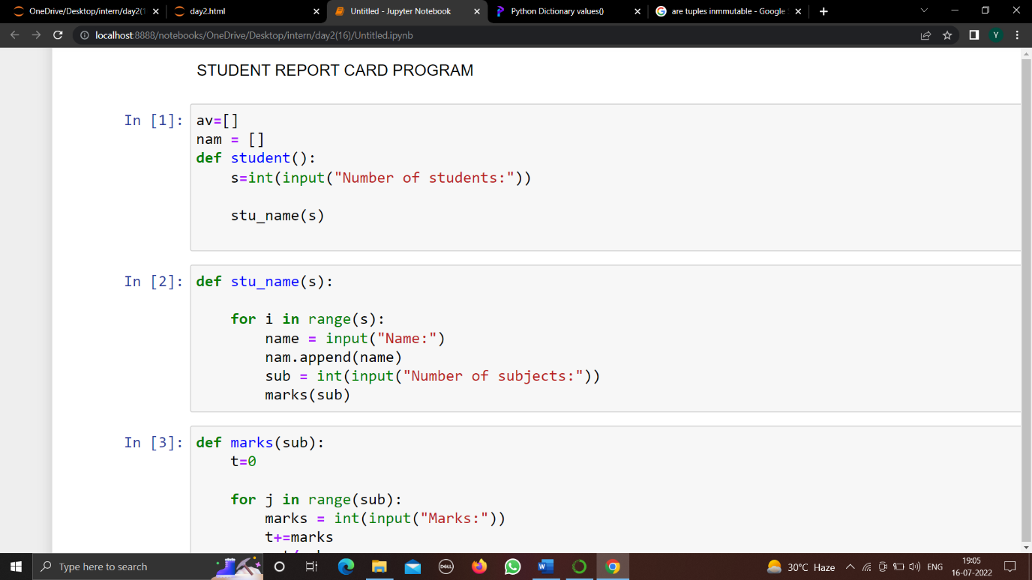
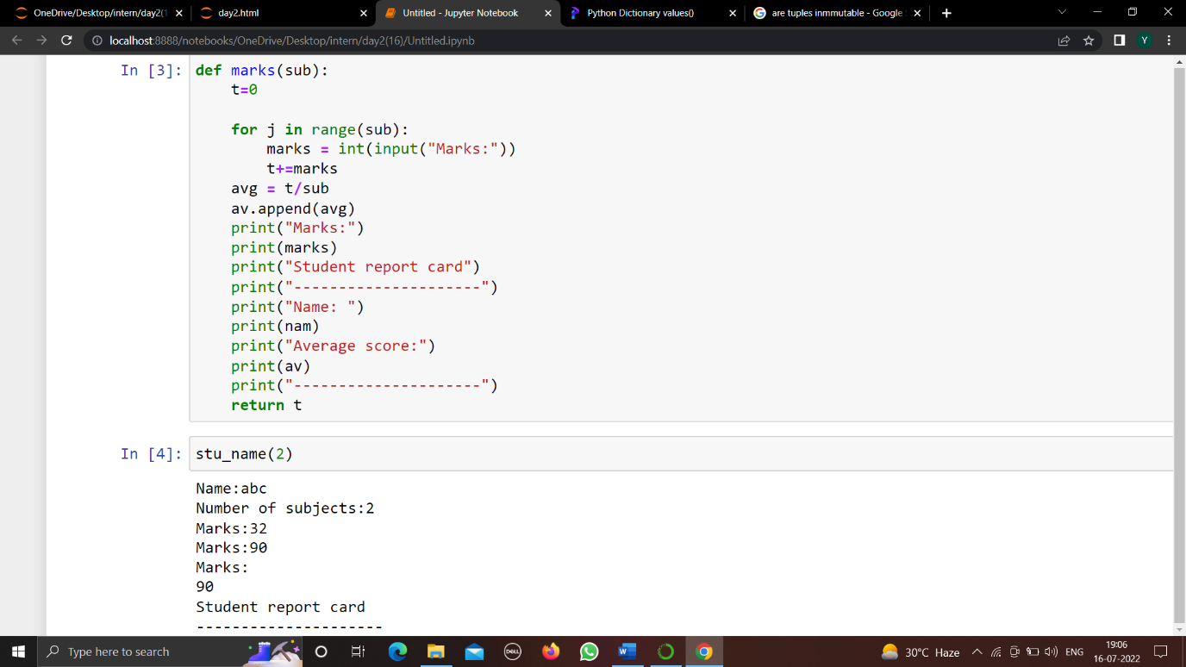
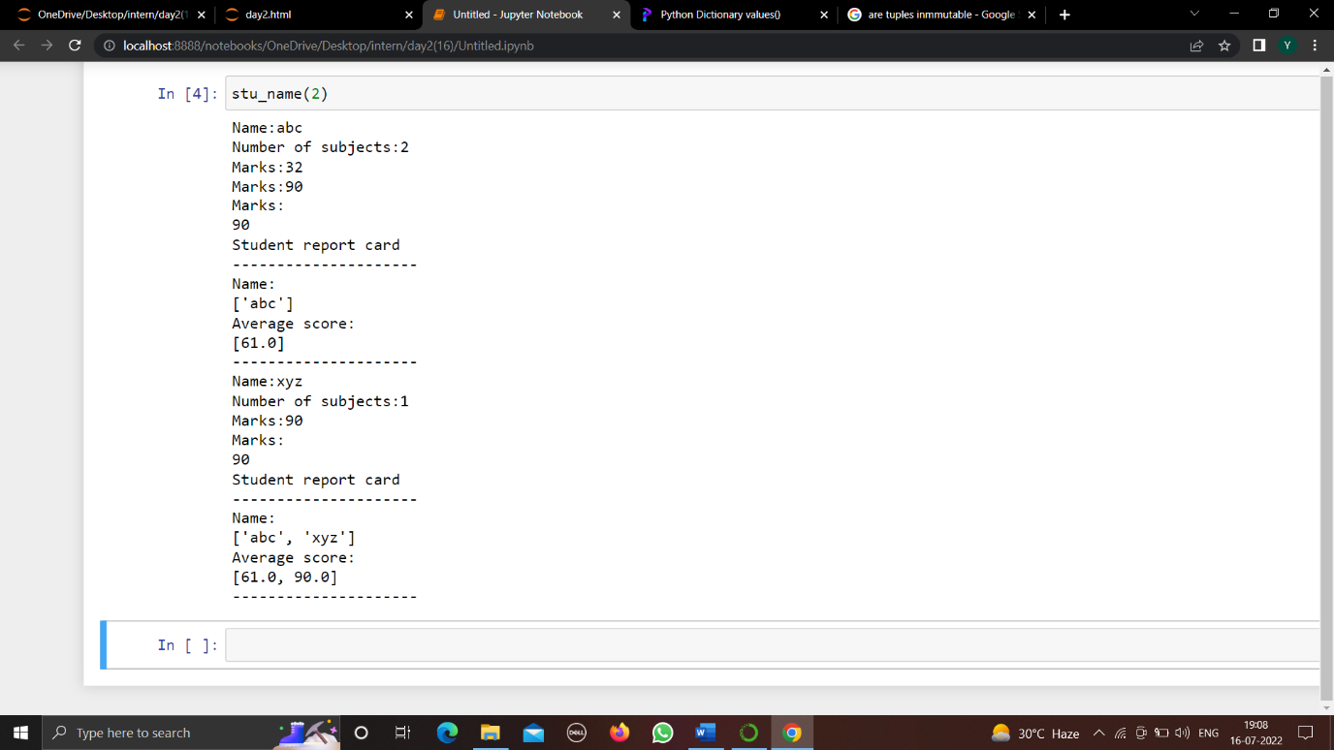
TASK-5
Build a student report card program which can take subject, marks as input and return the marks of students using functions.

Slide 28
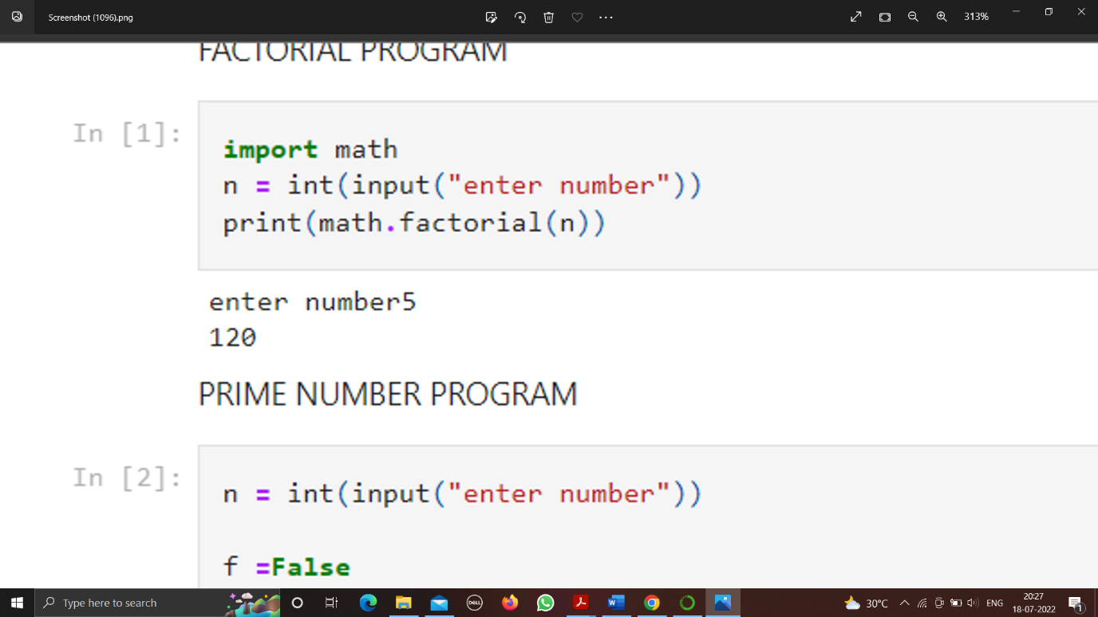
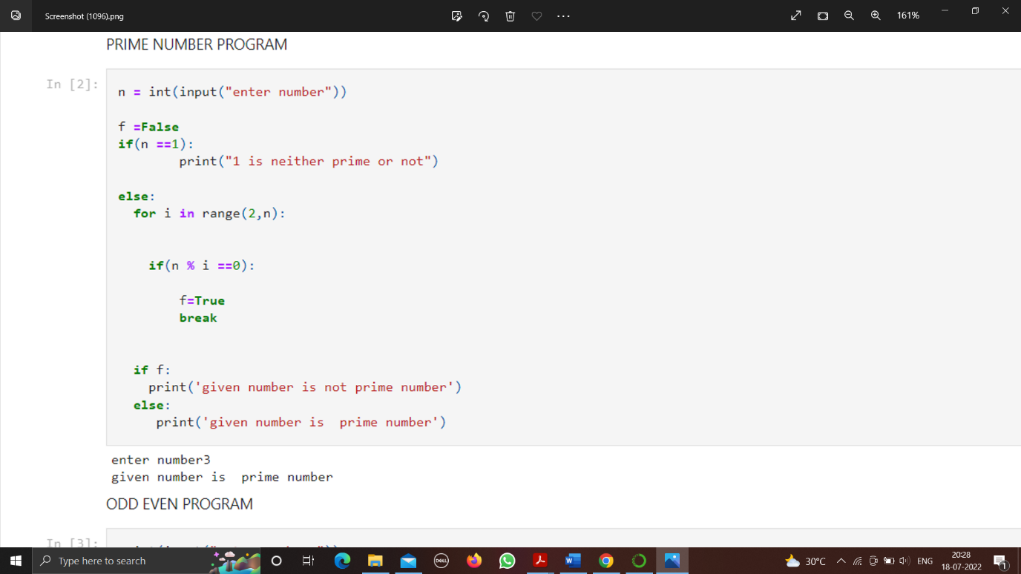
TASK-6
Build a program to find factorial, prime and odd even from user input.
FACTORIAL PROGRAM-
PRIME NUMBER PROGRAM-

Slide 29
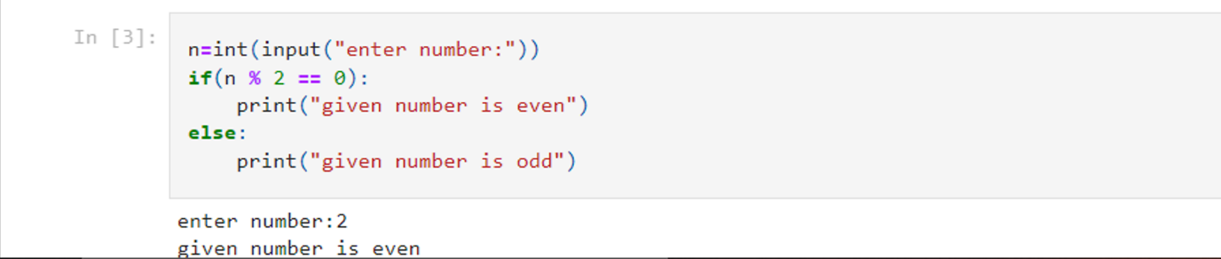
ODD EVEN PROGRAM-

Slide 30
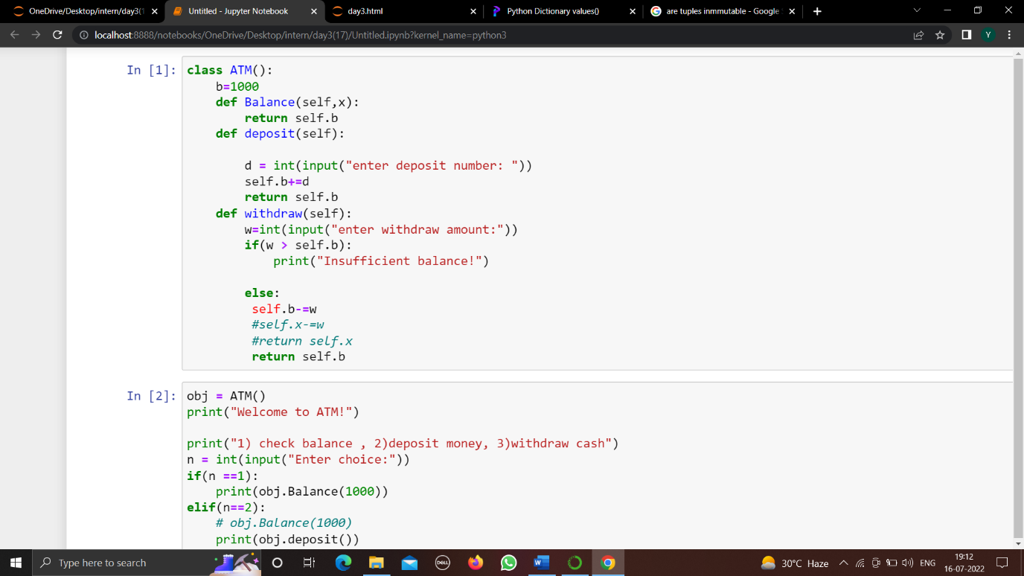
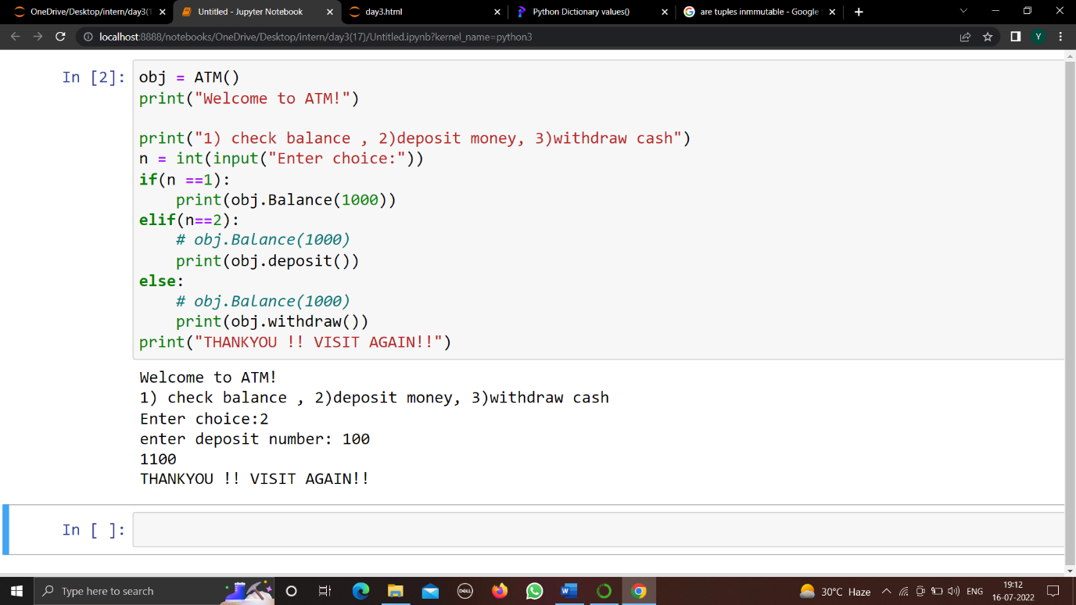
DAY - 3
TASK-7
Build a ATM program containing deposit and withdraw functions with validations and loop using class.

Slide 31
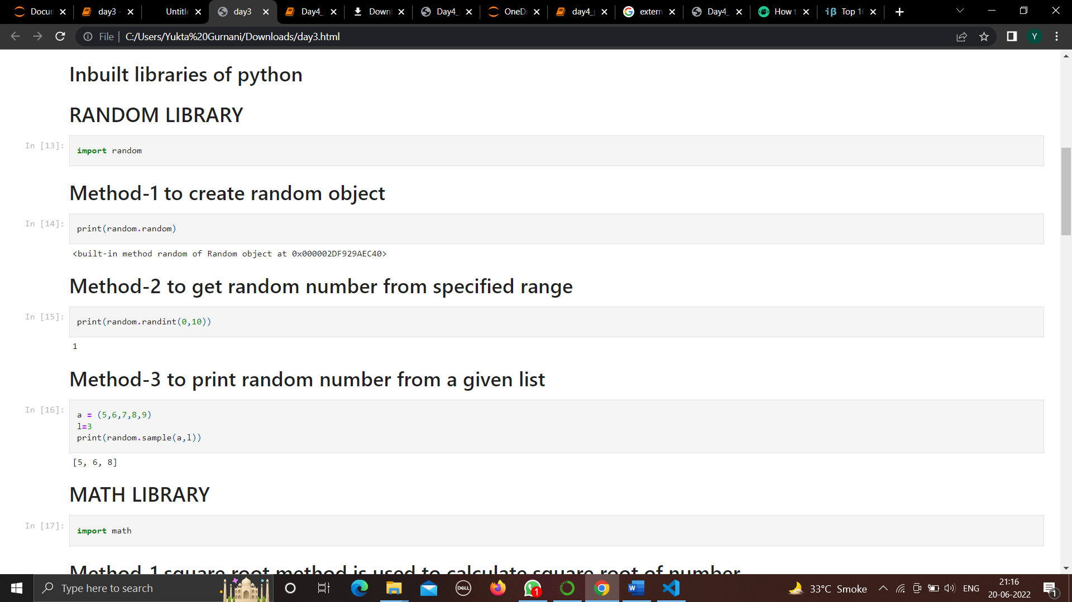
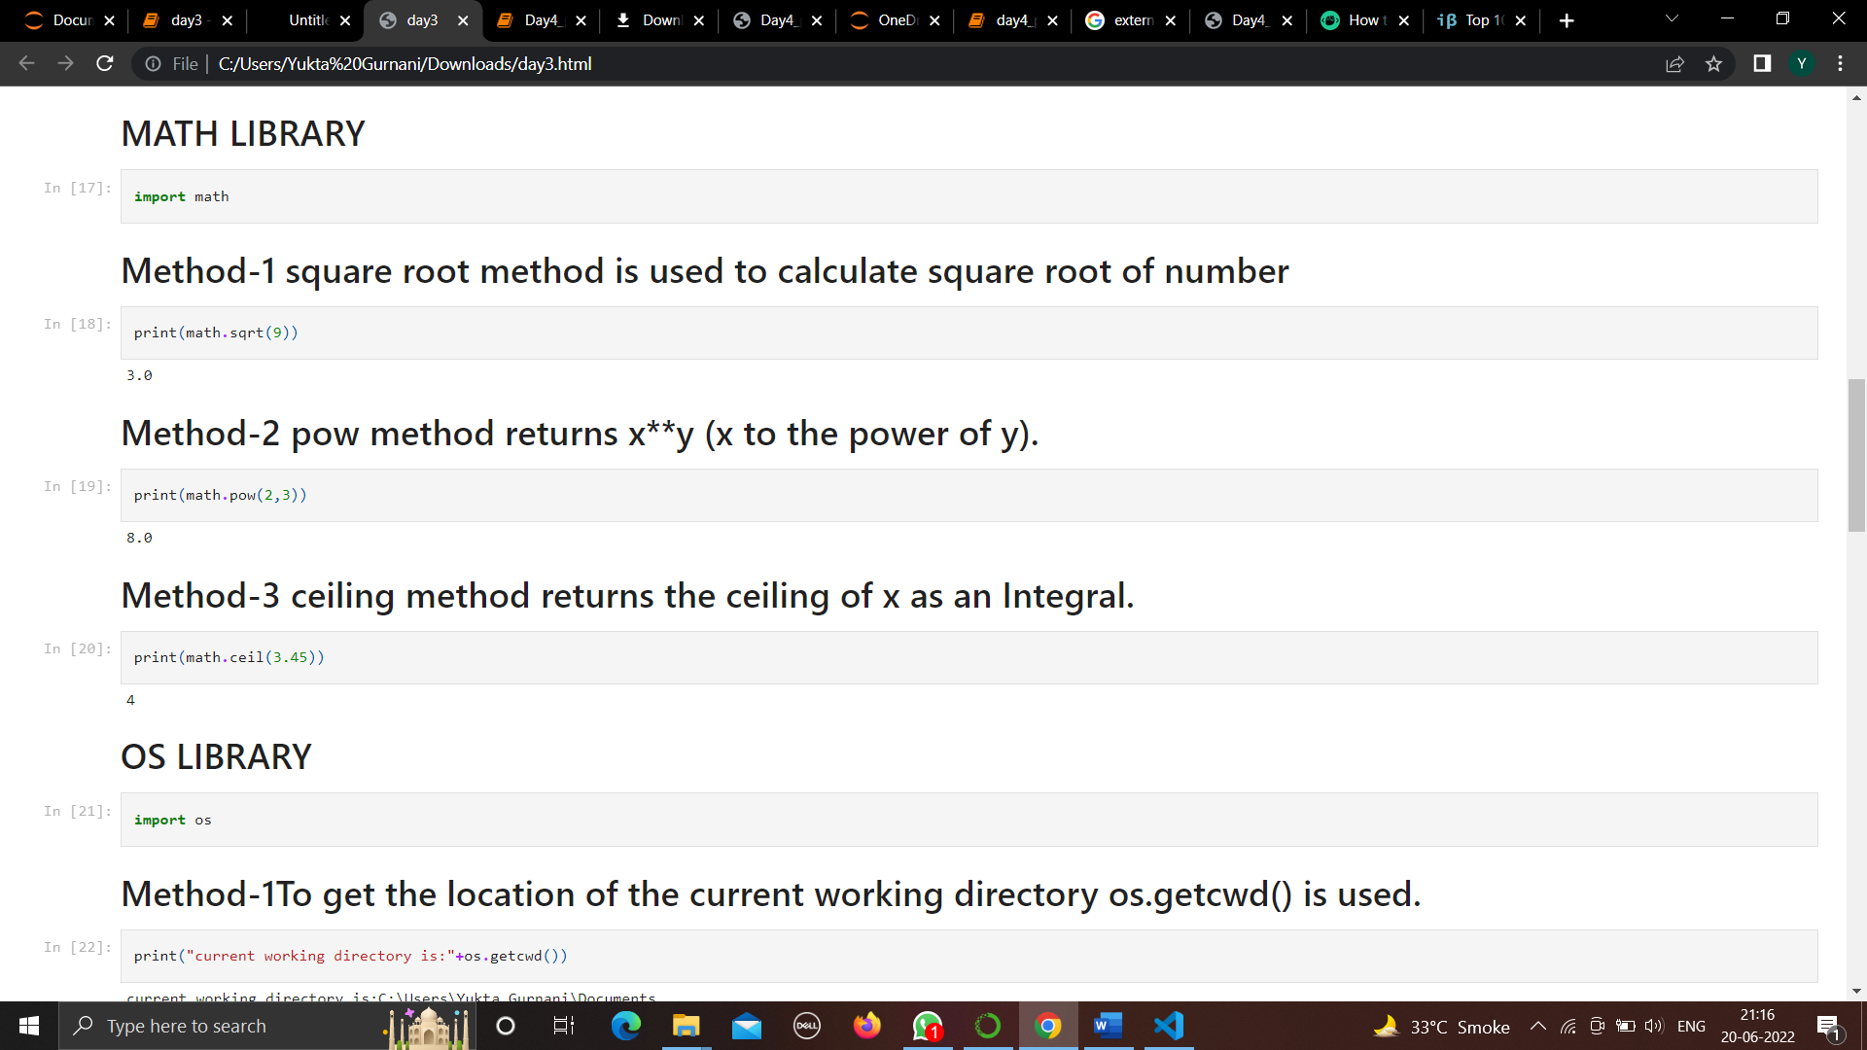
TASK-8
List out 5 inbuilt libraries of python and use their 3 methods with examples.

Slide 32
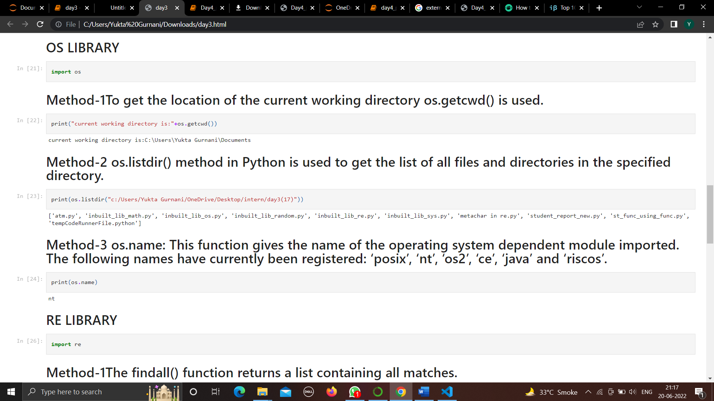
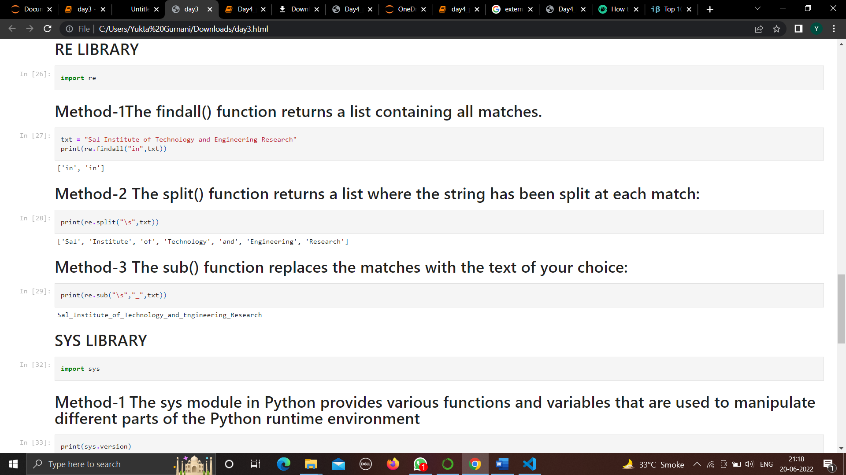

Slide 33
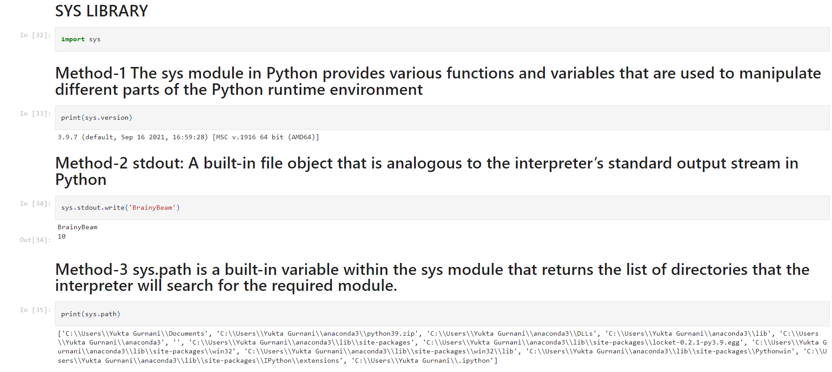

Slide 34
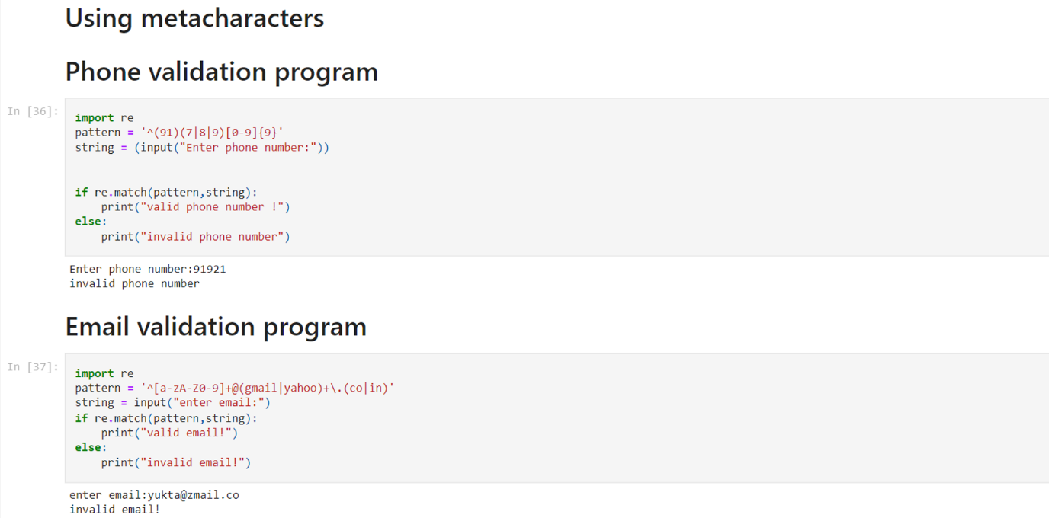
TASK-9
List out at least 10 meta characters and use them in pattern for email and phone validation
1) [] A set of characters
2) \ Signals a special sequence (can also be used to escape special characters)
3) . Any character (except newline character)
4) ^ Starts with
5) $ Ends with
6) * Zero or more occurrences
7) + One or more occurrences
8) ? Zero or one occurrences
9) {} Exactly the specified number of occurrences
10) | Either or

Slide 35
DAY-4
TASK-10
Use any external library and inbuilt library in one python program with user input.
Generating audiobook using external and internal libraries
For this task, I have used gtts (Google Text To Speech) as an external library.
For internal library, re i.e. regular expression has been used.
Basically, I have created a python program for generating an audiobook for the filename given by the user with the help of gtts library.
To clean up the text for better listening experience following regular expression has been used.
clean_src = [re.sub('\[\d\]','',i) for i in src]

Slide 36
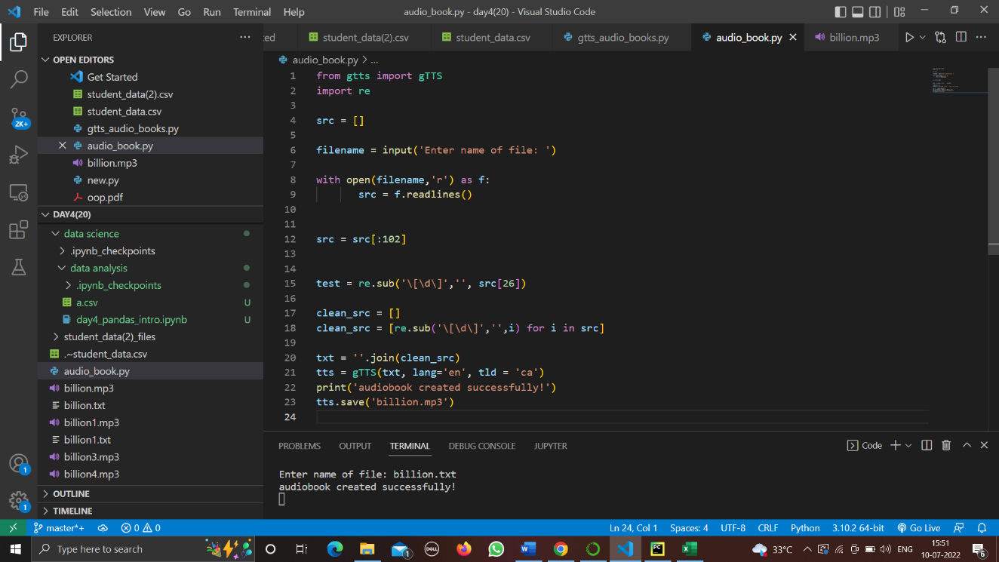
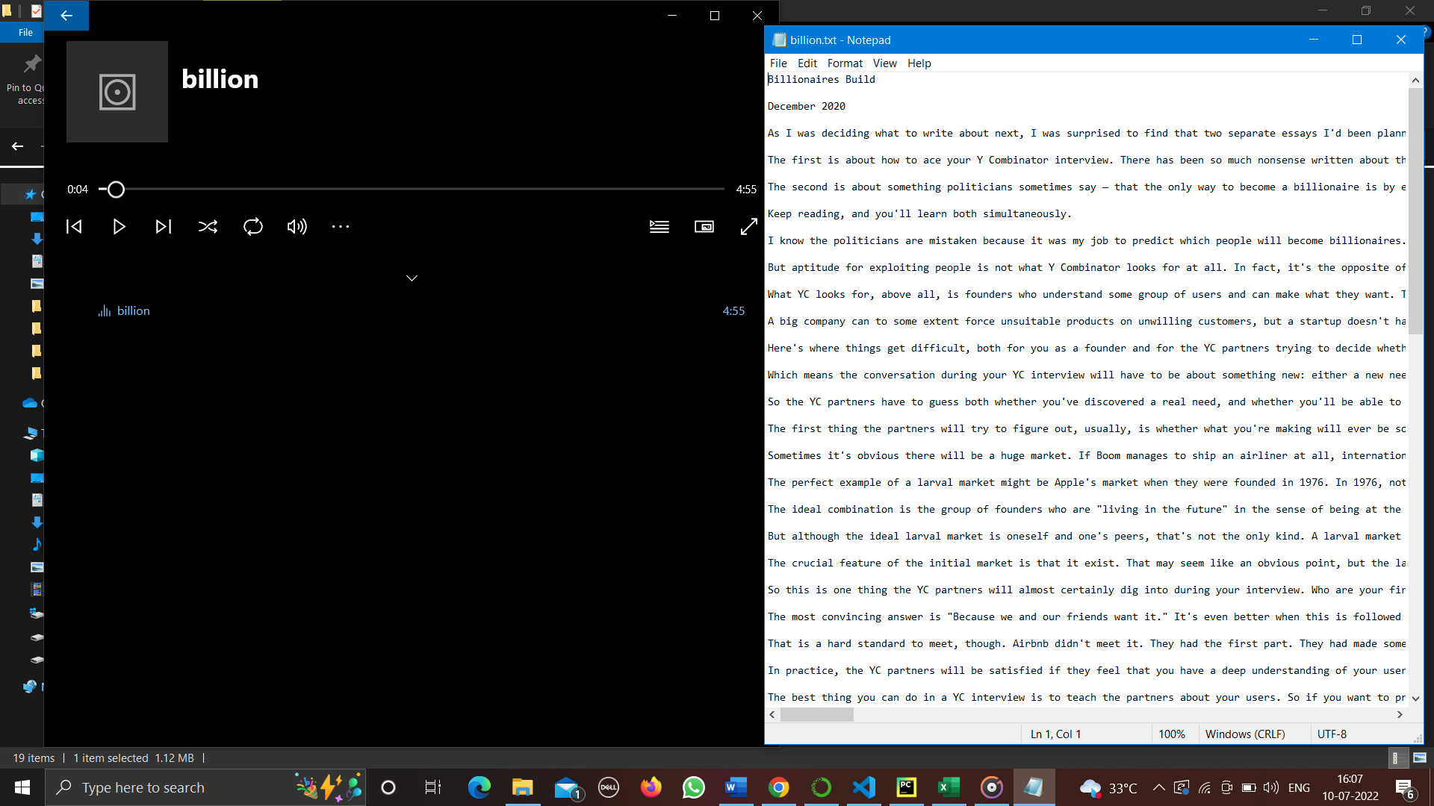

Slide 37
TASK-11
Explain pandas applications and list out at least 5 methods of pandas and explain them with example.
Different Applications of Pandas
This list will cover quite a few industries and the sectors where Pandas finds its applications.
1. Recommendation systems on Online Platforms:
While streaming on any media channel like Netflix or Spotify, we have been surprised by the recommendations these sites provide which are almost always close to heart. Well, the magic behind all of this is Deep Learning.
There are various models set which take different criteria into account and provide recommendations. These systems are one of the most widespread applications of Pandas. In most of these cases, the models are coded in python and pandas is the best library to use when you have handled such data in these models.
Pandas can handle a large amount of data which helps it in learning the tonnes of data it requires to build a good recommendation system. Functions like mapping and GroupBy are instrumental in making these recommendation systems workable.

Slide 38
2. Economics:
Data analysis is a constant need for Economics because it's always changing. The data needs to be analysed to create patterns and trends which are then analysed and interpreted to understand how the economy in various sectors is faring, something which is of extreme importance to economists.
A lot of modern-day economists have taken to pandas and python to handle huge datasets and interpret that data. Pandas have an extensive list of inbuilt tools and functions that make it the efficient package it is.
Tools like file-handling and data frames are extremely useful to access data and manipulate it to get the results we want. These applications of Pandas has helped Economists all over the world to make breakthroughs and studies they could not do earlier.
3. Neuroscience:
Understanding how our brains (and consequently the entire nervous system) work has been an unfulfilled wish of doctors since time immemorial because they believe that it will help discover answers to many mysteries that our body holds.
Machine Learning, driven by the numerous applications of pandas, has helped this field a lot. Once again, pandas' great capability of data manipulation has played a huge role. They have helped compile copious amounts of data and analysed it to produce results which are quite significant for neuroscientists.

Slide 39
4. Prediction of stocks:
Few things in the world are as volatile as the stock market. This is literally one of the biggest datasets in the world. Although it is almost impossible to predict the changes in stock market, with the correct application of Pandas and some help from a few libraries like MatPlotLib and NumPy, you can easily make models which can predict (to a large extent) how the stock market will turn out to be.
This is only possible because of the huge datasets we have in terms of the previous behaviour of the stocks which inform the system about their behaviour both individual ad codependently. By learning these behaviours and movements, a good model will be able to predict with quite a bit of accuracy as to what your next move should be.
5. Advertising:
With the advent of the 21st century, no field has progressed more than marketing has. Advertising has become more and more personalized. This change has once again been driven by Deep Learning and Machine Learning.
6. Statistical analysis:
Statistics itself means dealing with loads of data. Hence a library like pandas is able to help in various ways because it basically deals with various forms of data handling and its functions. The basic functions of mean, median, and mode are quite helpful while performing calculations based on statistics. There are loads of other functions in pandas which help you with getting better results in Statistics.

Slide 40
7. Natural Language Processing (NLP):
A very common buzzword right now, Natural Language Processing or NLP has announced its arrival to the world in style. The main purpose of this concept is to help computers understand the normal human language and the various nuances it possesses. This is quite a difficult task to accomplish, but with pandas at your service along with Scikit-Learn, you can create a basic model for NLP which you can enhance later on. You can use various functions and other libraries to help you out.
8. Analytics:
Analytics is everywhere. Whether you want to analyse a website or analyse any other platform, pandas helps you in doing it all. Its efficient data handling capabilities and dynamic data manipulation combined with its amazing visualization capabilities play a huge role in helping it ace this field.
9. Data science:
Most of the examples we have discussed are a part and parcel of data science. It is a huge umbrella which covers any and every field that deals with the analysis, handling, and manipulation of data. Therefore almost all of pandas applications fall under it.
10. Big Data:
Python has a great link with Spark and Hadoop. Therefore Pandas can work with Big data too.

Slide 41
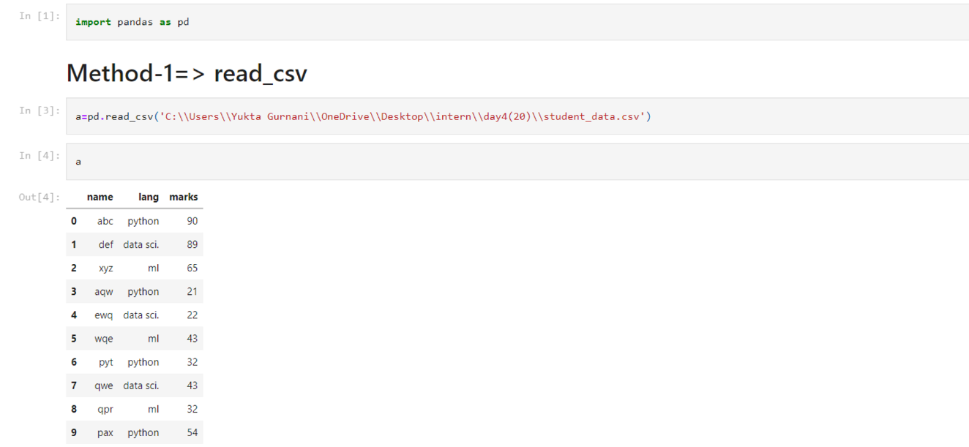
Method-1:
read_csv(): Reading a CSV using Python's inbuilt module called csv using csv.
Method-2:
DataFrame() function is used to create a dataframe in Pandas. The syntax of creating dataframe is: pandas.DataFrame(data, index, columns).

Slide 42
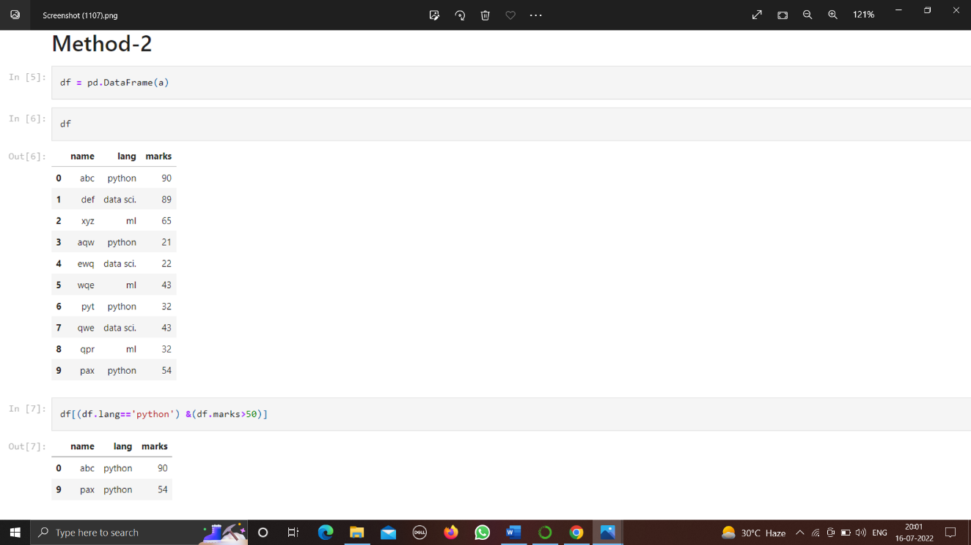
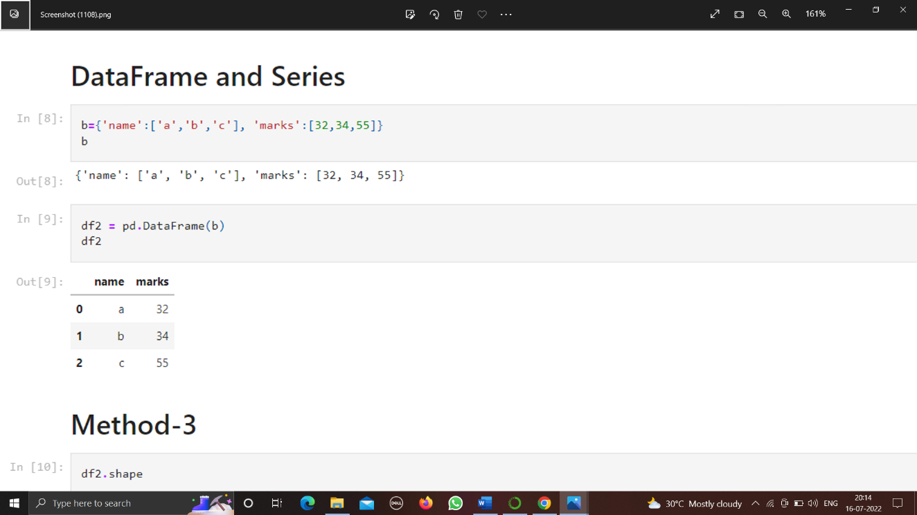

Slide 43
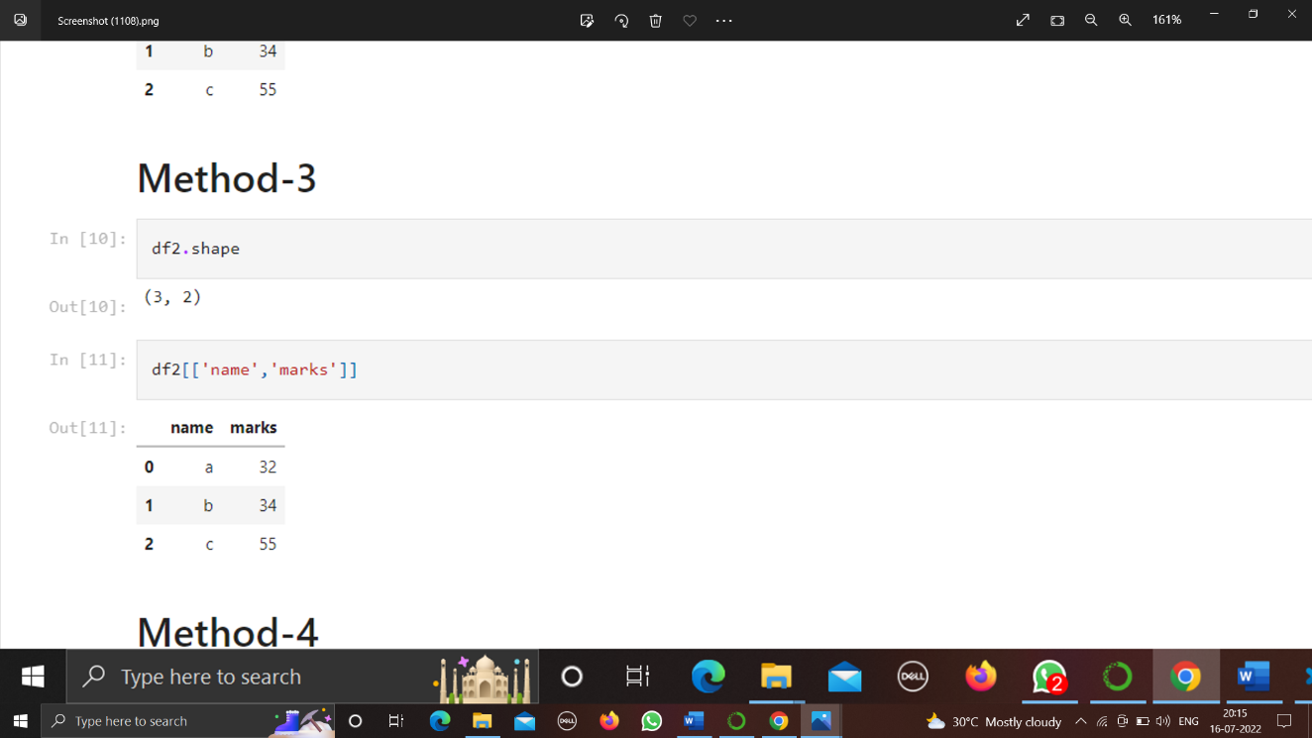
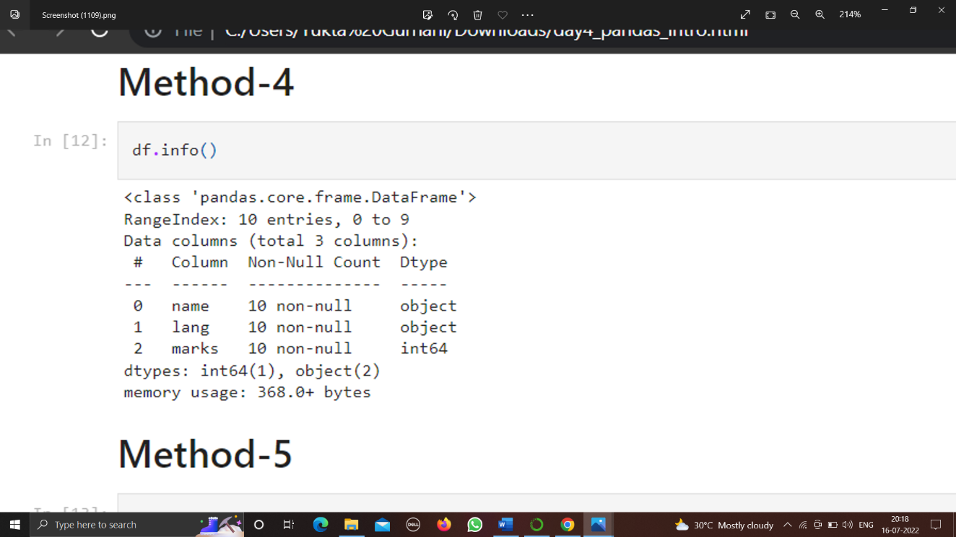
Method-3:
DataFrame.shape
Return a tuple representing the dimensionality of the DataFrame.
Method-4:
info(): The info() method prints information about the DataFrame. The information contains the number of columns, column labels, column data types, memory usage, range index, and the number of cells in each column (non-null values).

Slide 44
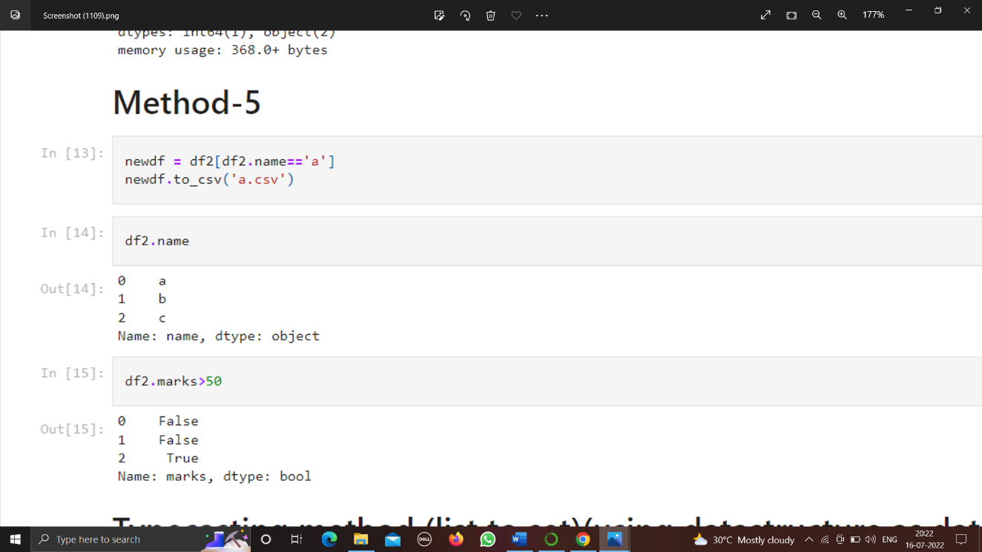
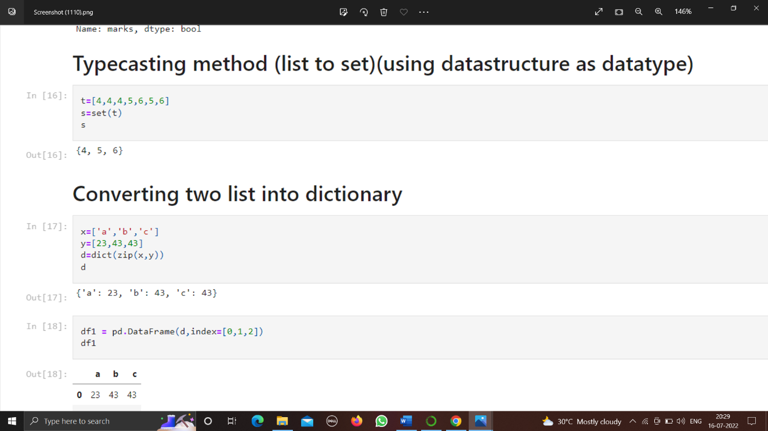
Method-5:
to_csv() function to convert the given Series object into a comma separated format.
Method-6:
This approach is one of the simplest methods of converting a list into a set. All you need is to use the set() constructor and pass the list as an argument.

Slide 45
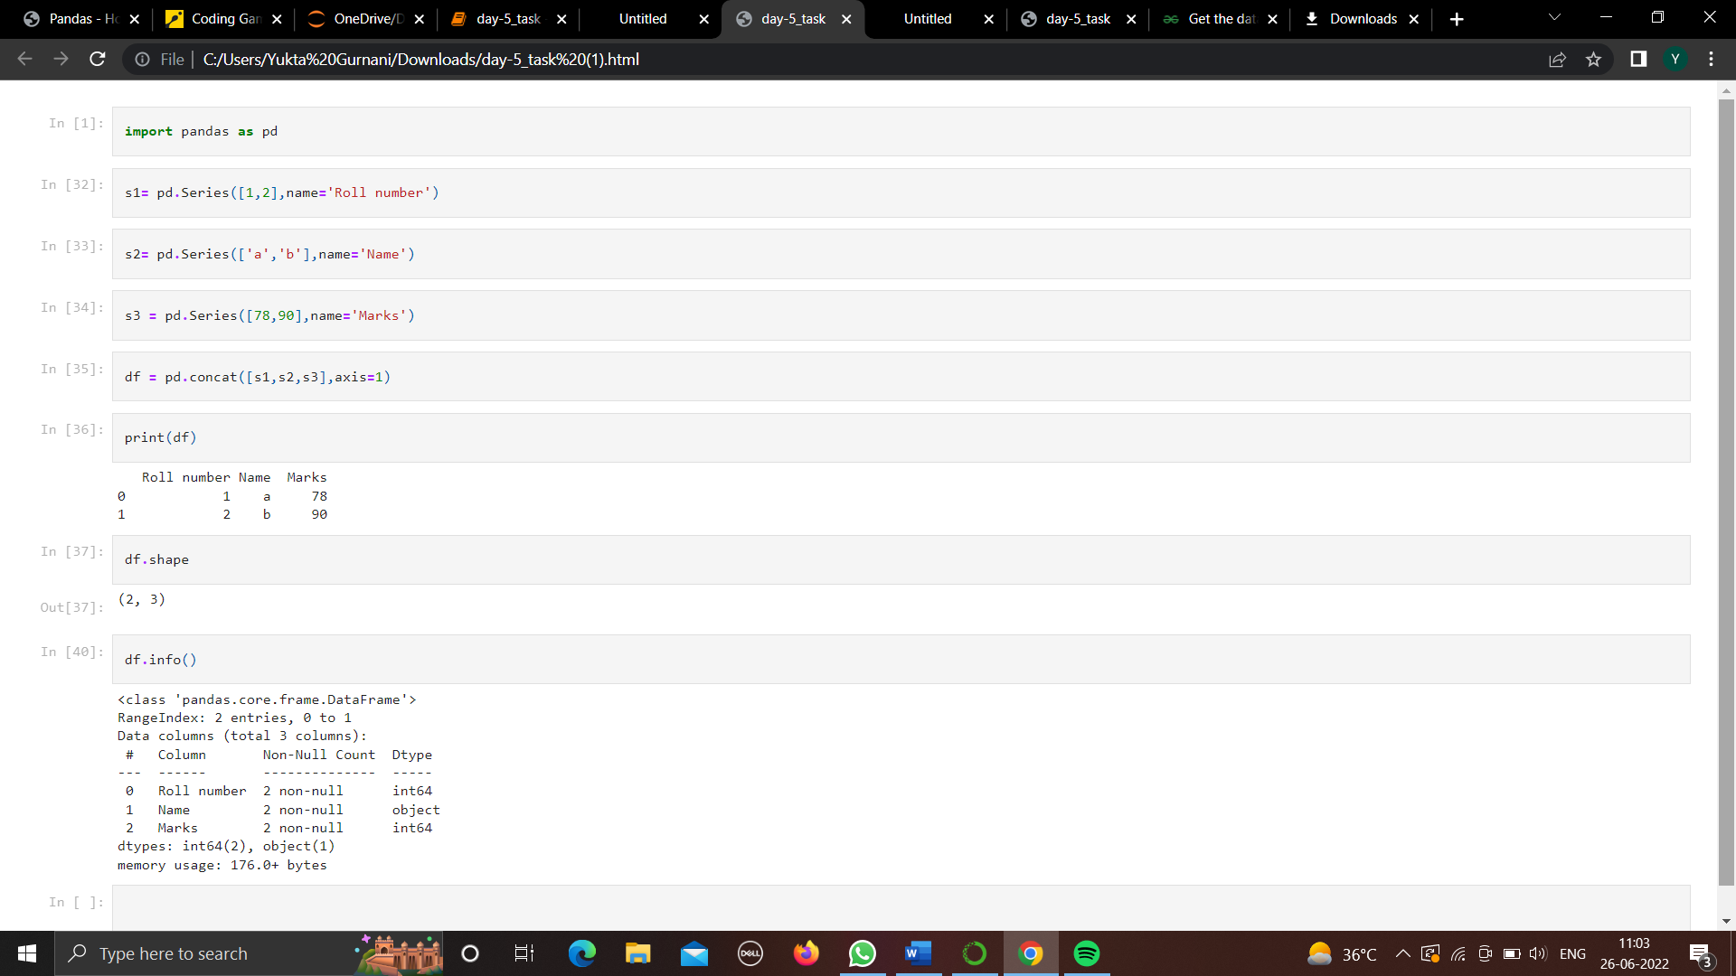
DAY-5
TASK-12
Convert multiple Series to Dataframe and find the shape and datatype of each column.

Slide 46
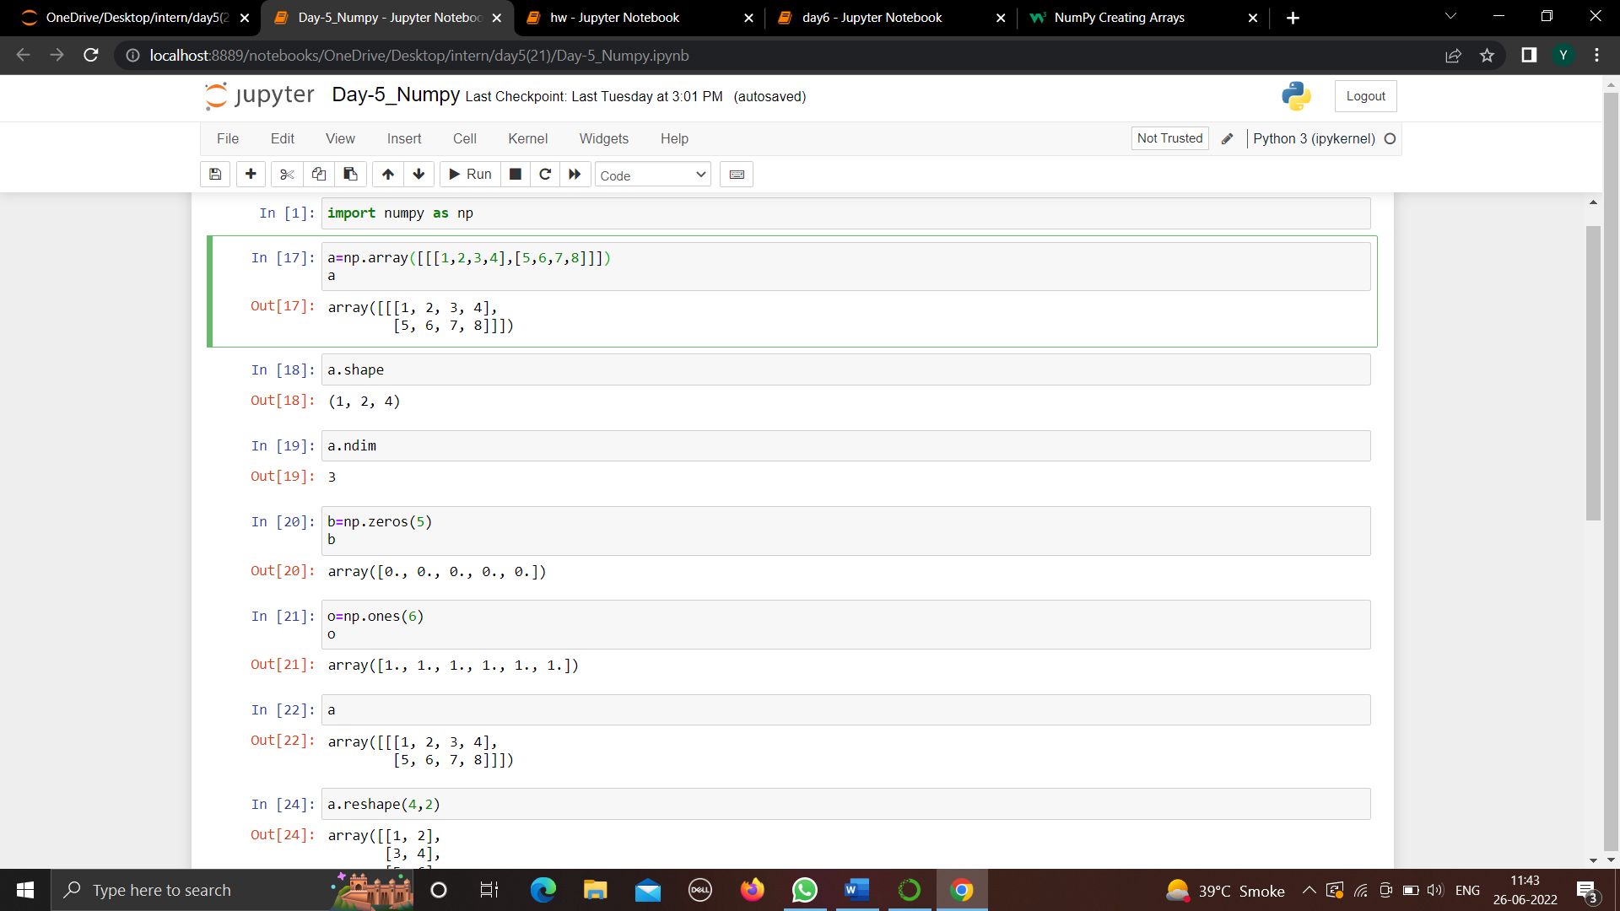
DAY-6
TASK-13
List out and explain atleast five functions of numpy and matplotlib with practical examples.
numpy functions-
1)array- NumPy is used to work with arrays. The array object in NumPy is called ndarray.
We can create a NumPy ndarray object by using the array() function
2)shape-NumPy arrays have an attribute called shape that returns a tuple with each index having the number of corresponding elements.
3)reshape- Reshaping means changing the shape of an array.
The shape of an array is the number of elements in each dimension.
By reshaping we can add or remove dimensions or change number of elements in each dimension.

Slide 47
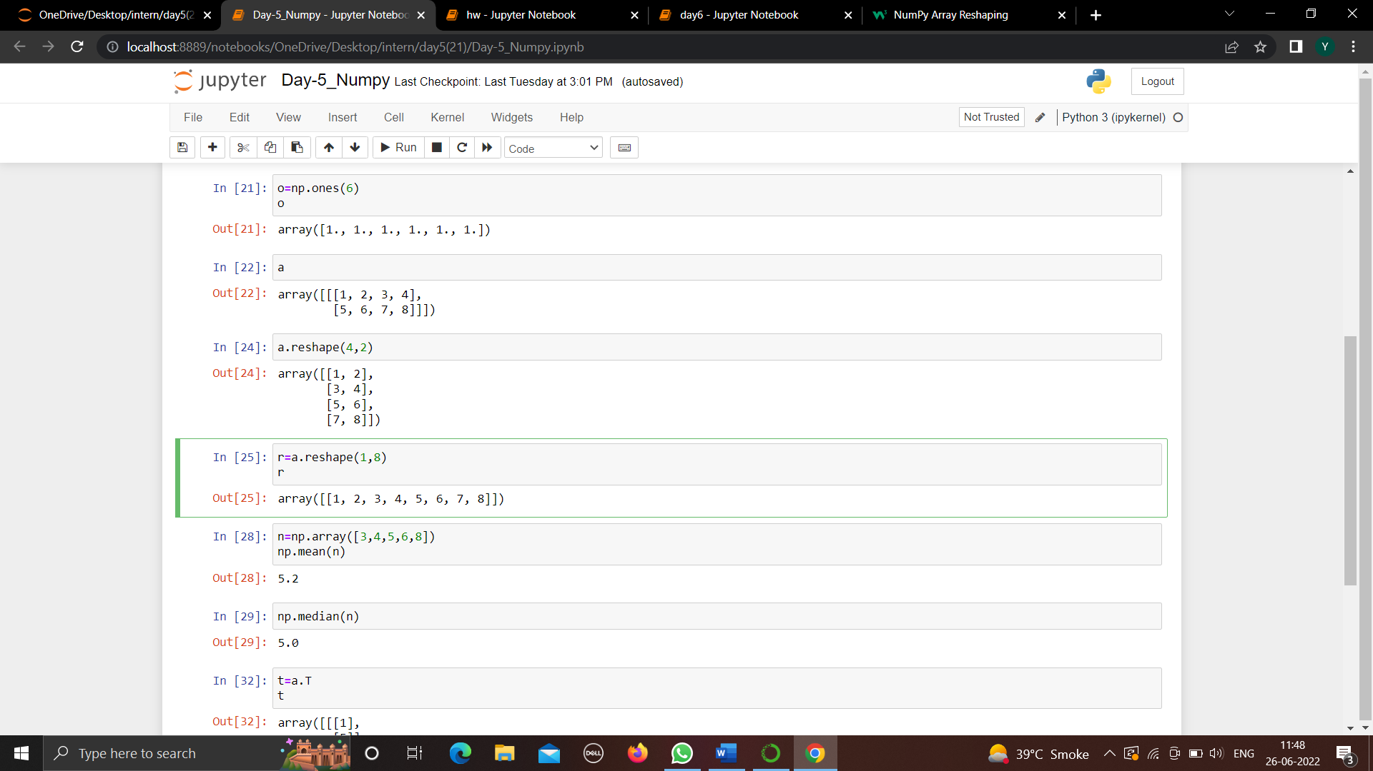
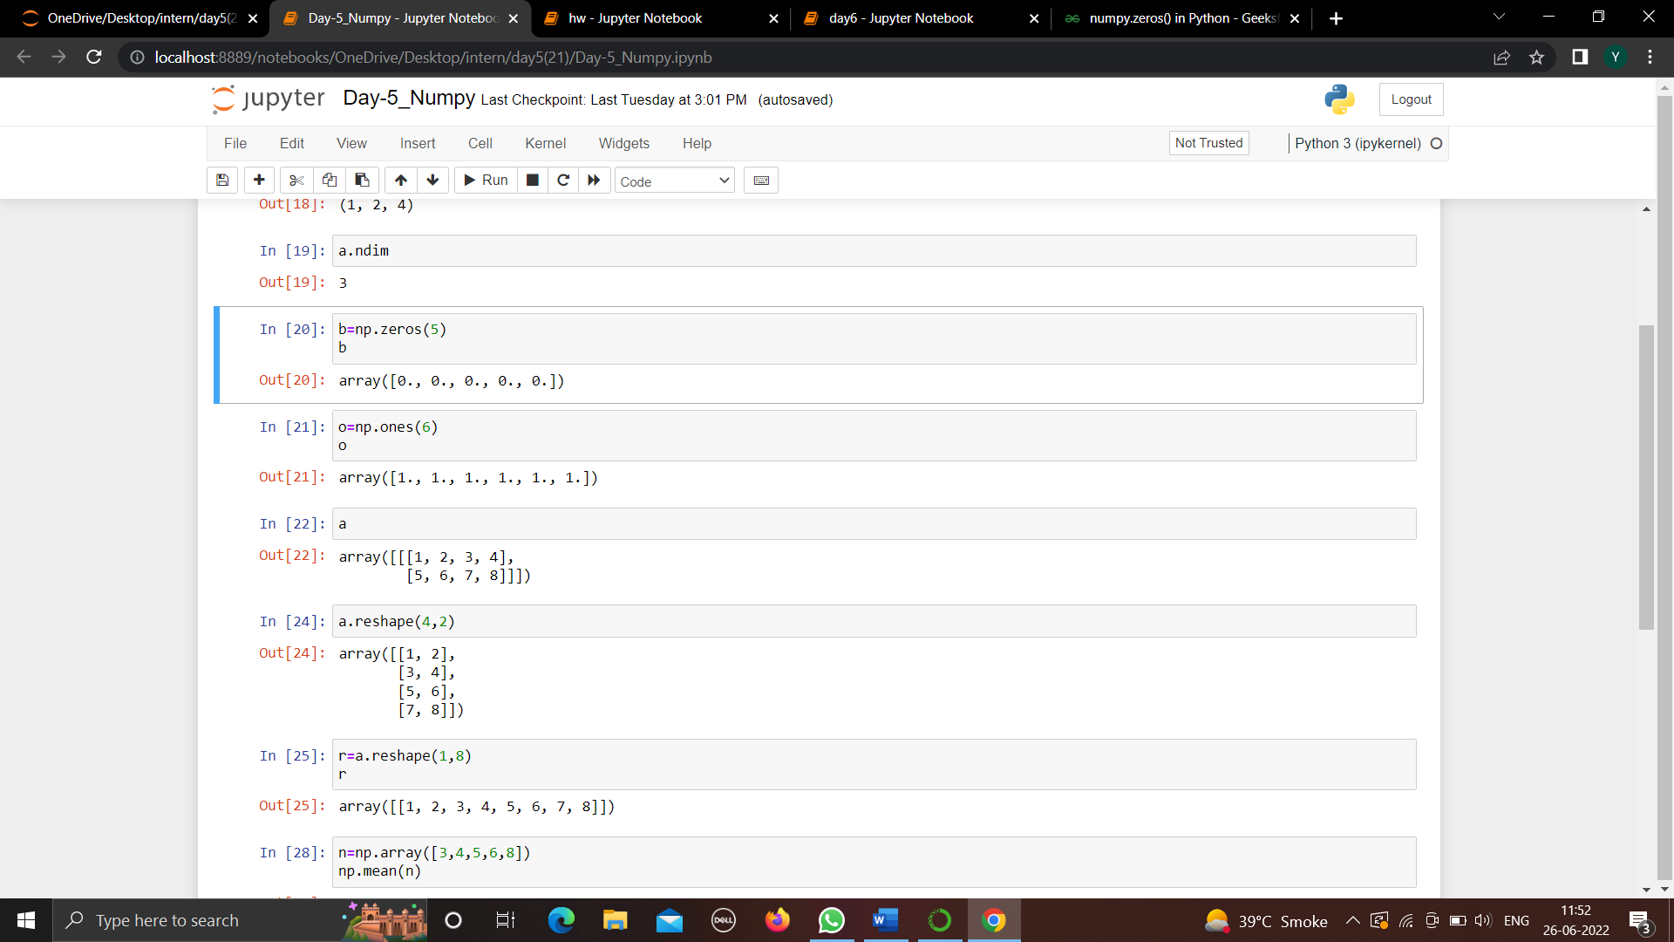
4)mean-Compute the arithmetic mean (average) of the given data (array elements) along the specified axis
5)zeros()-The numpy.zeros() function returns a new array of given shape and type, with zeros.
Matplotlib functions-
matplotlib.pyplot.ylabel()-This function sets the label for the y-axis of the plot.

Slide 48
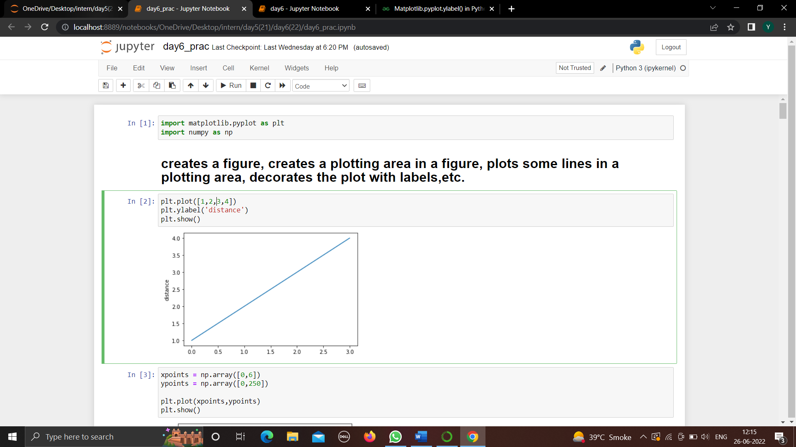
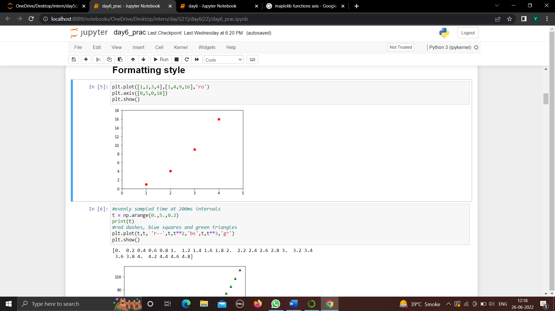
axis-Axes object is the region of the image with the data space. A given figure can contain many Axes, but a given Axes object can only be in one Figure. The Axes contains two (or three in the case of 3D) Axis objects.
subplot()-subplot() function adds subplot to a current figure at the specified grid position. It is similar to the subplots() function however unlike subplots() it adds one subplot at a time.

Slide 49
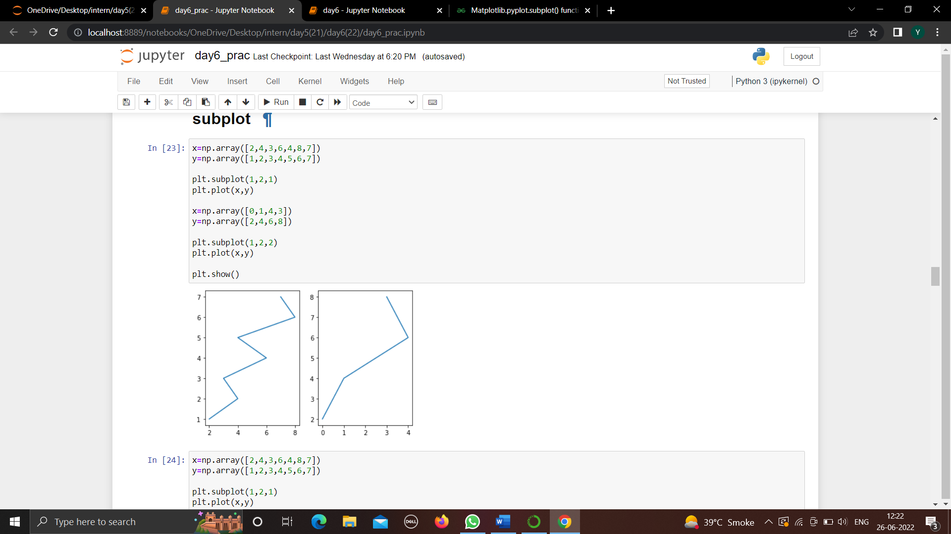
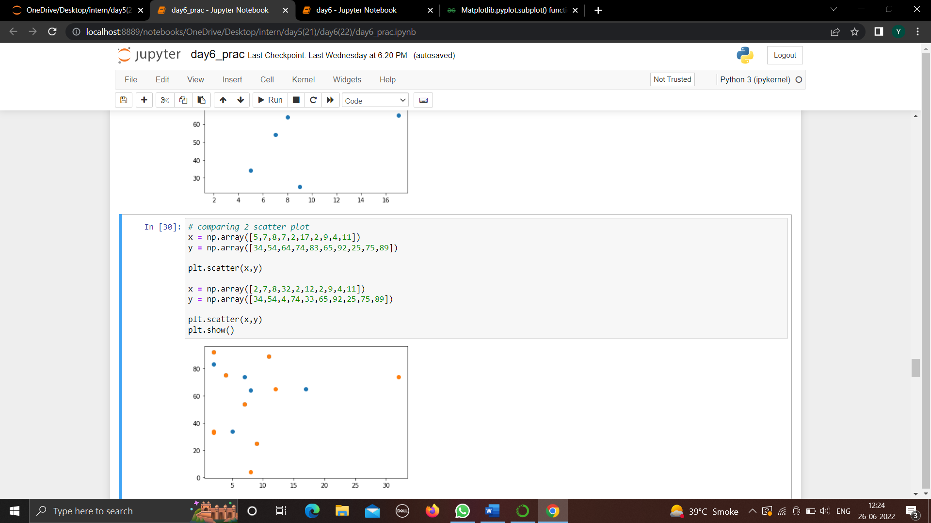
4)scatter-Scatter plots are used to observe relationship between variables and uses dots to represent the relationship between them. The scatter() method in the matplotlib library is used to draw a scatter plot. Scatter plots are widely used to represent relation among variables and how change in one affects the other.

Slide 50
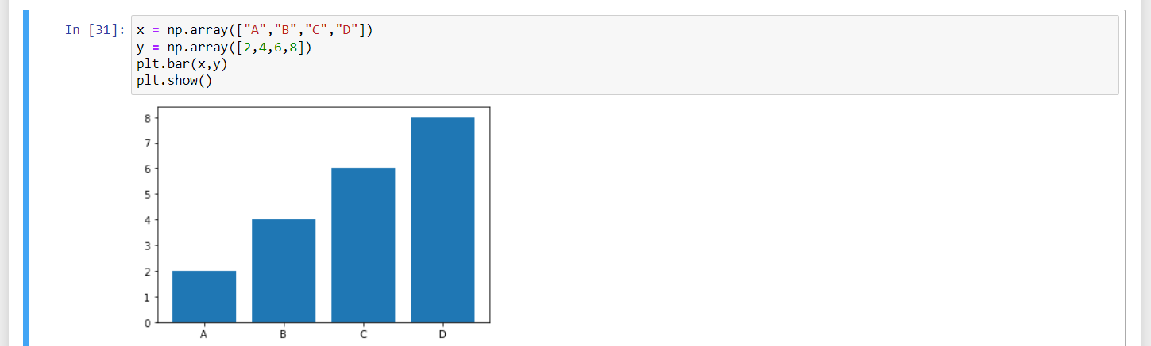
5)bar()-The function creates a bar plot bounded with a rectangle depending on the given parameters.

Slide 51
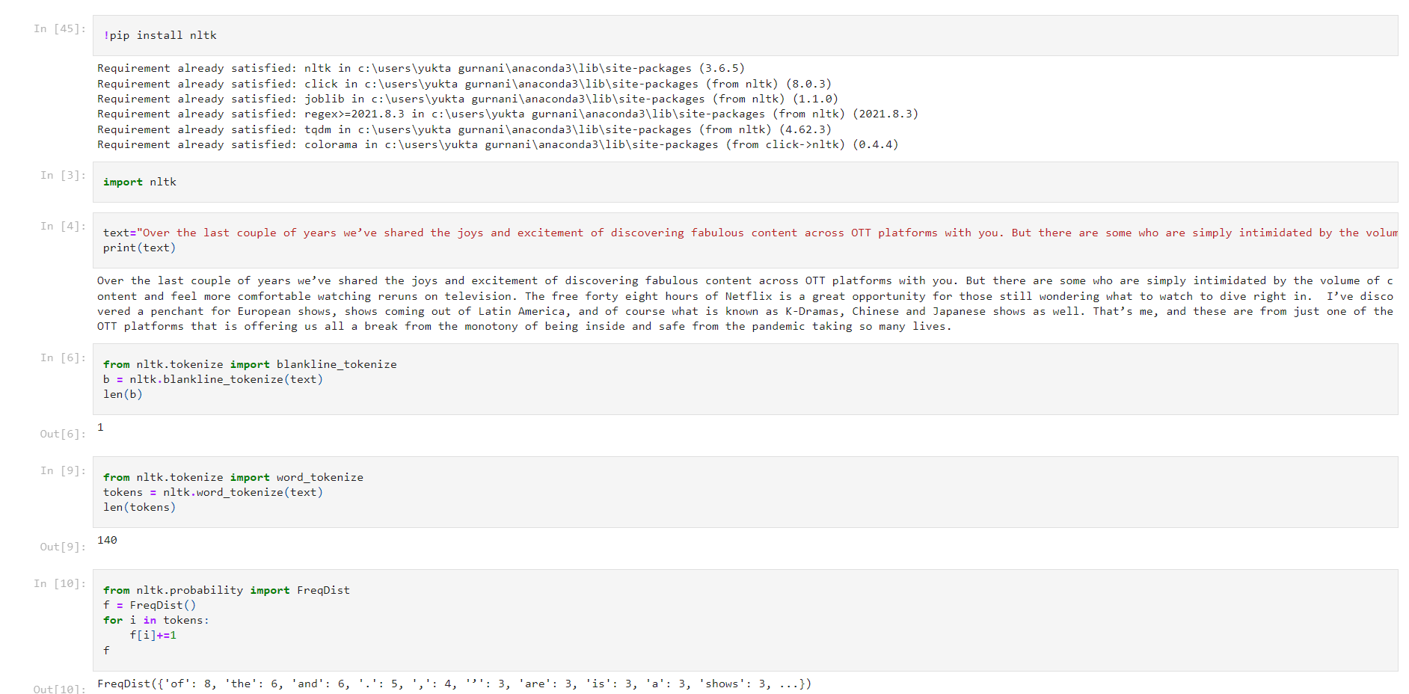
DAY-7
TASK-14
Download and use the nltk packages and corpus data with example.

Slide 52
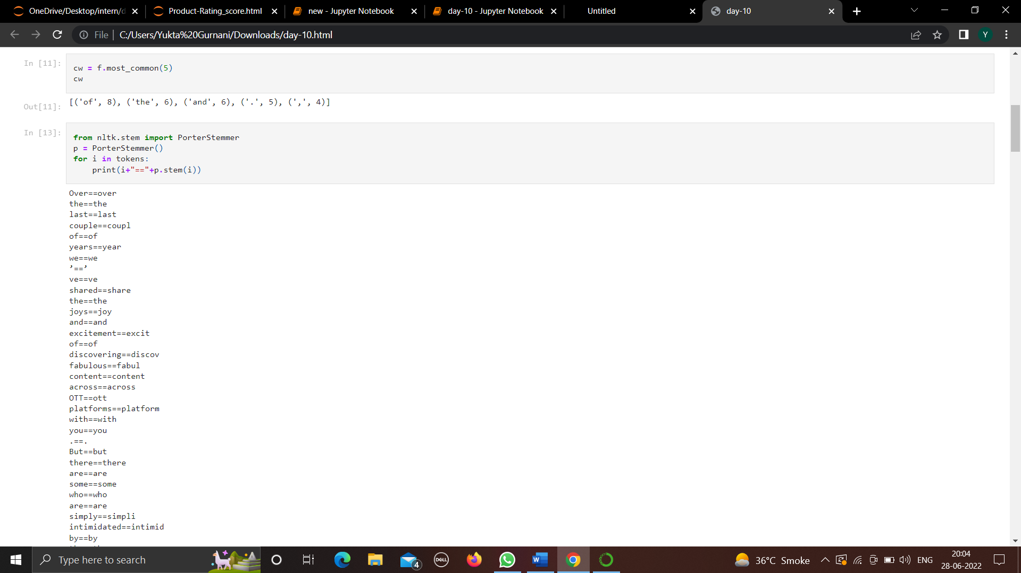


Slide 53



Slide 54



Slide 55


Slide 56


TASK-15
Use tokenization, stemming, lemmatization and frequency distribution from corpus data.
Tokenization-

Slide 57



Stemming-
Lemmatization-
Frequency Distribution-

Slide 58

DAY-8
TASK-16
Explanation TF IDf Text Vectorization with equation and example.
Text Vectorization: Term Frequency — Inverse Document Frequency (TFIDF)
A technique for converting text into finite length vectors. Bag of words (BoW) converts the text into a feature vector by counting the occurrence of words in a document. It is not considering the importance of words. Term frequency — Inverse document frequency (TFIDF) is based on the Bag of Words (BoW) model, which contains insights about the less relevant and more relevant words in a document. The importance of a word in the text is of great significance in information retrieval.
Example — If you search something on the search engine, with the help of TFIDF values, search engines can give us the most relevant documents related to our search.
Term Frequency (TF)
It is a measure of the frequency of a word (w) in a document (d). TF is defined as the ratio of a word’s occurrence in a document to the total number of words in a document. The denominator term in the formula is to normalize since all the corpus documents are of different lengths.

Slide 59


EXAMPLE
The initial step is to make a vocabulary of unique words and calculate TF for each document. TF will be more for words that frequently appear in a document and less for rare words in a document.

Slide 60


Inverse Document Frequency (IDF)
It is the measure of the importance of a word. Term frequency (TF) does not consider the importance of words. Some words such as’ of’, ‘and’, etc. can be most frequently present but are of little significance. IDF provides weightage to each word based on its frequency in the corpus D.
IDF of a word (w) is defined as
In our example, since we have two documents in the corpus,
Term Frequency — Inverse Document Frequency (TFIDF)
It is the product of TF and IDF.

Slide 61


TFIDF gives more weightage to the word that is rare in the corpus (all the documents).
TFIDF provides more importance to the word that is more frequent in the document.

Slide 62
After applying TFIDF, text in A and B documents can be represented as a TFIDF vector of dimension equal to the vocabulary words. The value corresponding to each word represents the importance of that word in a particular document.
Why are we using Ln in the IDF formula?
TFIDF is the product of TF with IDF. Since TF values lie between 0 and 1, not using ln can result in high IDF for some words, thereby dominating the TFIDF. We don’t want that, and therefore, we use ln so that IDF should not completely dominate the TFIDF.
Disadvantage of TFIDF
It is unable to capture the semantics. For example, funny and humorous are synonyms, but TFIDF does not capture that. Moreover, TFIDF can be computationally expensive if the vocabulary is vast.
Conclusion
Term Frequency — Inverse Document Frequency (TFIDF) is a technique for text vectorization based on the Bag of words (BoW) model. It performs better than the BoW model as it considers the importance of the word in a document into consideration. The main limitation is that it does not capture the semantic meaning of the words. This limitation of TFIDF can be overcome by more advanced techniques such as word2Vec.
Example-

Slide 63



Slide 64




Slide 65


TASK-17
Load data from json file and find total words and sentences from that.

Slide 66


DAY-9
TASK-18
Use label encoding on user id and product id in dataset.

Slide 67



Slide 68


TASK-19
Clean the Text using stopwords and re from Feedback column.
Cleaning data-
Using re to remove punctuation-

Slide 69



Slide 70



Slide 71


TASK-20
Generate a new score by merging the rating and sentiment score.

Slide 72

DAY-10
TASK-21
Find the cosine similarity between products.
We calculate the Cosine Similarity between the two non-zero vectors. A vector is a single dimesingle-dimensional signal NumPy array. Cosine similarity is a measure of similarity, often used to measure document similarity in text analysis. We use the below formula to compute the cosine similarity.
Similarity = (A.B) / (||A||.||B||)
where A and B are vectors:
A.B is dot product of A and B: It is computed as sum of element-wise product of A and B.
||A|| is L2 norm of A: It is computed as square root of the sum of squares of elements of the vector A.

Slide 73

DAY-11
TASK-22
Build a pie chart of sentiment analysis containing percentage of positive, negative and neutral reviews.
The main objective is to display the sentiment analysis values positive, negative and neutral of any user input in a pie chart.

Slide 74

DAY-12
TASK-23
Find the nearest neighbours and their distance values with their indices.

Slide 75


DAY-13
TASK-24
Build a recommendation engine using KNN.

Slide 76
DAY – 14
TASK-25
Explain radius and n_neighbours parameter of KNN.
Parameters
1) n_neighbors int, default=5
Number of neighbours to use by default for kneighbors queries.
2) Radius float, default=1.0
Range of parameter space to use by default for radius_neighbors queries.
3) algorithm{‘auto’, ‘ball_tree’, ‘kd_tree’, ‘brute’}, default=’auto’
Algorithm used to compute the nearest neighbours:
‘ball_tree’ will use BallTree
‘kd_tree’ will use KDTree
‘brute’ will use a brute-force search.
‘auto’ will attempt to decide the most appropriate algorithm based on the values passed to fit method.
Note: fitting on sparse input will override the setting of this parameter, using brute force.
4) leaf_sizeint, default=30
Leaf size passed to BallTree or KDTree. This can affect the speed of the construction and query, as well as the memory required to store the tree. The optimal value depends on the nature of the problem.

Slide 77
5) metricstr or callable, default=’minkowski’
The distance metric to use for the tree. The default metric is minkowski, and with p=2 is equivalent to the standard Euclidean metric. For a list of available metrics, see the documentation of DistanceMetric and the metrics listed in sklearn.metrics.pairwise.PAIRWISE_DISTANCE_FUNCTIONS. Note that the “cosine” metric uses cosine_distances. If metric is “precomputed”, X is assumed to be a distance matrix and must be square during fit. X may be a sparse graph, in which case only “nonzero” elements may be considered neighbors.
6) p int, default=2
Parameter for the Minkowski metric from sklearn.metrics.pairwise.pairwise_distances. When p = 1, this is equivalent to using manhattan_distance (l1), and euclidean_distance (l2) for p = 2. For arbitrary p, minkowski_distance (l_p) is used.
7) metric_paramsdict, default=None
Additional keyword arguments for the metric function.
8) n_jobsint, default=None
The number of parallel jobs to run for neighbors search. None means 1 unless in a joblib.parallel_backend context. -1 means using all processors.

Slide 78


DAY – 15
TASK- 26
Convert the Recommendations in Dataframe containing product and their distance.

Slide 79
chapter:5 PROJECT
5.

Slide 80


PROJECT – BOOK RECOMMENDATION SYSTEM
BOOK RECOMMENDATION WITHOUT SENTIMENT ANALYSIS

Slide 81



Slide 82



Slide 83



Slide 84



Slide 85


BOOK RECOMMENDATION WITH SENTIMENT ANALYSIS-

Slide 86



Slide 87



Slide 88



Slide 89



Slide 90



Slide 91



Slide 92



Slide 93



Slide 94



Slide 95



Slide 96



Slide 97



Slide 98



Slide 99


Slide 100
chapter:6 CONCLUSION
6.

Slide 101
First of all , this internship has provided me the opportunity to explore the domain of Data Science and Machine Learning. During the initial phases of internship, we started learning from the basics of python. Then gradually our work flow shifted towards the understanding of our project title Recommender System with Sentiment Analysis.
Sentiment Analysis is a type of analysis made on the basis of reviews given by the customers in context to a particular product. Then the analysis obtained is converted into numeric format within some range. This can be clubbed with original rating of product to obtain a more authentic and finer rating which actually depicts how worthy the product is.
In this project I have even learned to make recommendation engine. My project gives recommendation of books when the user inputs id of book. Using sentiment analysis with recommendation system improves the results of recommendation. Organizations use such results helps in improving customer satisfaction which eventually increases their profits.
This internship has helped me to improve my knowledge in technical as well as professional work field. Finally, I would like to thank all my mentors for supporting me throughout the entire internship period.

